Slide 1



Cybersecurity
Awareness
Presentation
Notes:
Cannot promise this training will be exhilarating and exciting, but I can promise that it is important.
I do want to say on the front end that there are a couple of different points within this training where I ask for some audience participation, the training does work a little better when the audience is engaged, if no one feels comfortable participating, that is fine, I am pretty well practiced at talking a lot.
Also, we will have some time at the end of the training for questions and discussion, but do not feel like you need to hold questions or input until the end, if you have a question about material on the slide, please ask it! And I will do my best to address it.

Slide 2

INTRODUCTION
Michelle Tuttle, M.S.
VP Client Relations & Business Development
Manages all client engagements
BS degree in Communications and Marketing from SUNY Poly
Master's degree in Cyber Security from Utica College.
Expertise in cybersecurity, compliance, risk management and marketing/PR
Identity Theft Prevention Expert
15+ years experience in financial operations
10+ years experience in cybersecurity & risk management
Notes:
Now on to me, name is Addison Wolanin, I will be your trainer today.
I have worked for Anjolen for 4 years and work under the Policy, Risk, and Compliance Umbrella while also serving as one of the company’s educators.
While some larger organizations have dedicated trainers, Anjolen uses a hybrid approach and because I operate in the field of cybersecurity every day, we feel it gives me a unique perspective and up to date understanding of the current outlook of the cybersecurity realm.
I have a master’s degree from Utica College in Cybersecurity Policy and Risk.
I have worked in a multitude of different verticals including the not-for-profit, government, and corporate banking sectors and combining that experience with my education has given me a diverse perspective on just how important cybersecurity regardless of industry.

Slide 3


PURPOSE OF TODAY’S PRESENTATION
Gain an understanding of social engineering & human vulnerability trends
Identify current cyber attacks
Learn how to recognize cybersecurity vulnerabilities
Acquire tactics & best practices to mitigate your risk
Notes:
The purpose of this training is to enhance cyber security awareness
We will be reviewing some important cyber security topics that people in all fields of work should be aware of.
We will also go over some examples of phishing emails and learn how to identify them. These emails will include some of the most common ways in which malicious actors attempt to extort information from you.
I will then show you a password cracking tool and how quickly a malicious actor is able to gain access to your accounts if you have a simple or compromised password.
real life example of ransomware

Slide 4




CIA TRIAD
TYPES OF DATA
Confidentiality: protect sensitive information from unauthorized access attempts
Integrity: maintain the consistency, accuracy and trustworthiness of data
Availability: Information is consistently and readily accessible for authorized parties
PERSONALLY IDENTIFIABLE INFORMATION (PII)
PROTECTED HEALTH INFORMATION (PHI)
FINANCIAL INFORMATION
INTELLECTUAL PROPERTY
Notes:
When we talk about the CIA in cybersecurity, we are typically not referring to the Central Intelligence Agency, more likely we are talking about this CIA triad.
Confidentiality, integrity, and availability are the general parameters we hold data and information security up to.
Confidentiality:preserving and protecting data from unauthorized access
Integrity:ensuring data has not been improperly modified or destroyed
Availability: ensuring that data is available within a reasonable time and access to the data is reliable.
Availability can be compromised by denial-of-service attacks, amongst other things.
There are a few types of data that the CIA triad can be applied to to help protect.
Personally identifiable information is any information that can be used to identify you
Protected health information includes any health information that can be used to identify you such as test results, doctors visits, or billing information.
Financial Information is any information related to your financial activity.
Intellectual Property is any information you or your organization owns including patents, trademarks, and designs.

Slide 5
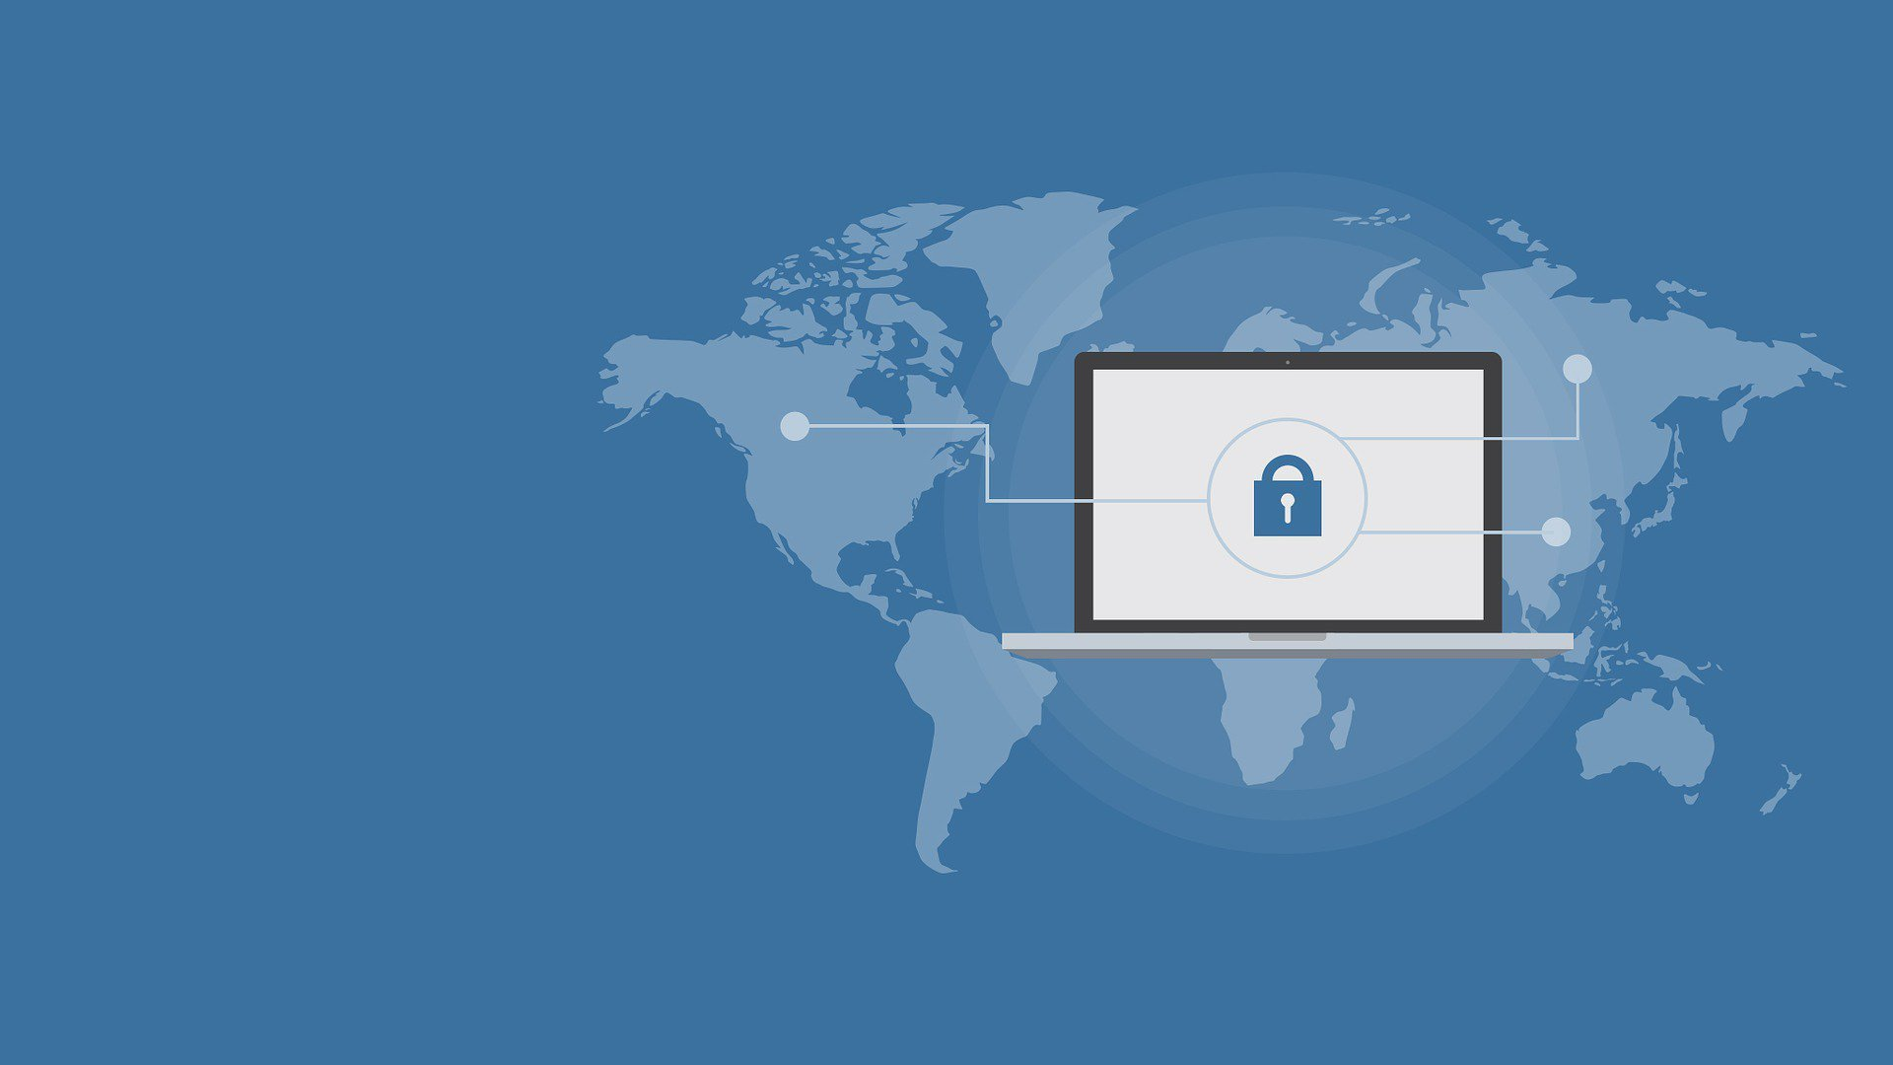
THE HUMAN VULNERABILITY
People are the most vulnerable part of any information technology system
94% of malware is delivered by email
  3.4 billion phishing emails are sent per day
  3% of targeted users report malicious emails to management
  The average cost of a malware attack on a company is $2.5 million
  The average cost in time of a malware attack is 50 days
Notes:
The most vulnerable part of any organization or system is actually you, the human operating it.
While there are automated systems and artificial intelligence, all computer processes require human input on some level which equals universality.
Malware needs some human input in order to begin spreading through a computer network, even if it is self-replicating
94% of all malware that is received by an organization is sent by email via phishing emails with about 3.4 billion of them being sent each day.
It is important to always report malicious emails to your management, only about 3% of users actually do this.
Malware attacks can cost enough to put small businesses out of operations with them costing on average 2.5 million dollars and the cost in time on average is 50 days.

Slide 6
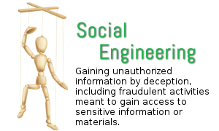
Types of Social Engineering
Phishing
Vishing
Smishing

Slide 7
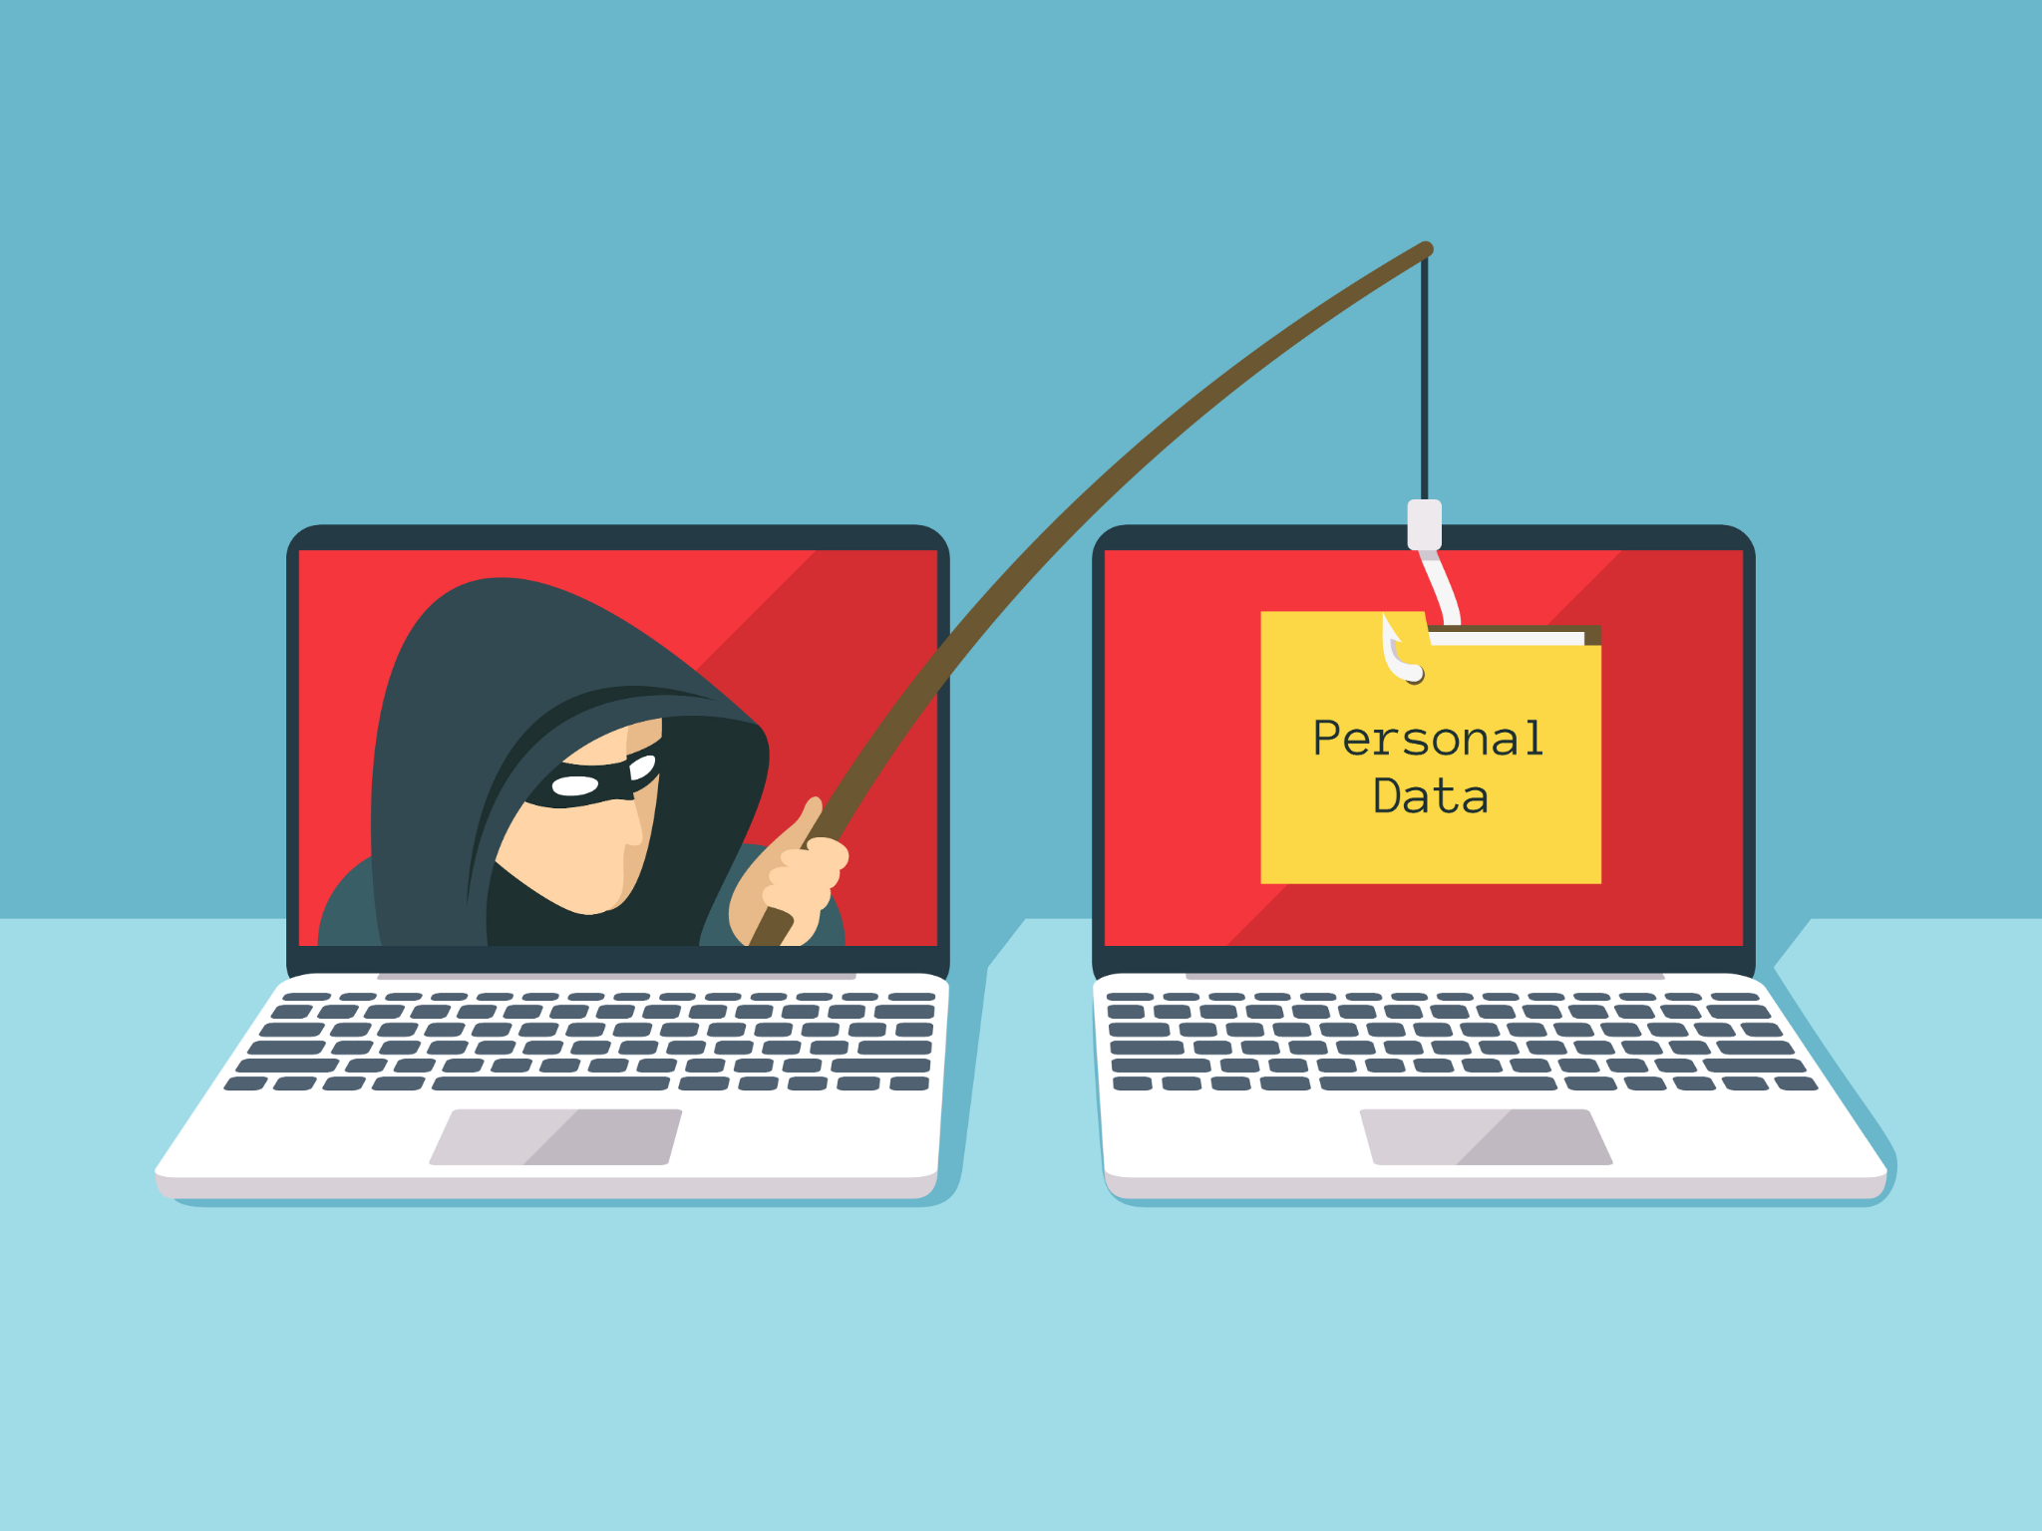
PHISHING
What is a phishing email?
  An online scam that targets consumers by sending them an e-mail that appears to be from a well-known source
How to identify a phishing email?
  General greeting
  Suspicious links/attachments
  Sense of urgency
Notes:
Now what exactly is phishing? I am sure most of you have heard of this in some way but may not be 100% on what it is and how to identify it.
This is an online scam that targets consumers by sending them an email that appears to be from a well-known source or has enticing information.
There are a few ways you can determine if an email is phishing.
First, if it has a general greeting such as just saying Hello. Malicious actors will keep mass phishing emails as broad as possible.
Suspicious links or attachments will often be included in phishing emails too.
They will often give some sense of urgency as well, like “If you do not click this link in 24 hours your account will be permanently locked”. This is to try and scare you in to

Slide 8
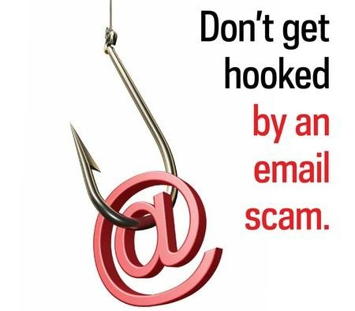
TYPES of PHISHING ATTACKS
Types of Phishing
Clone phishing attacks create an almost identical copy of a previous delivered legitimate email and attachment by using its recipient information and content to create trust and encourage the recipient to take action such as clicking on a malicious link.
Spear phishing attacks use personal information researched about targeted specific individuals or companies as a way to increase the success of enticing the target to surrender sensitive information.
Whaling attacks are targeted specifically at senior executives and other high profile individuals within your organization to try to solicit sensitive information.

Slide 9
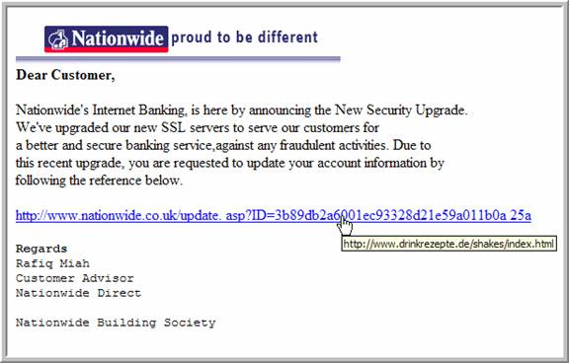
Example

Slide 10
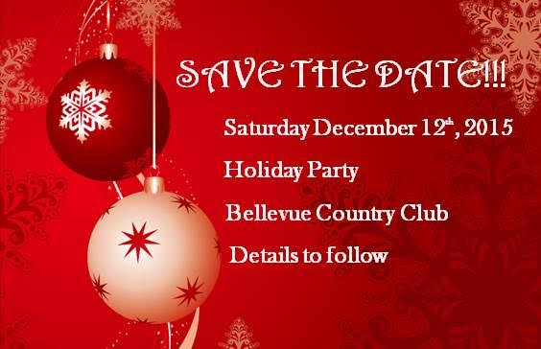
Example
To: 1-All Users
From: Human Resources Events
Subject: Holiday Party Give-away
The Holiday Party is quickly coming up! We have some tickets to give away for local holiday events like the Nut Cracker and Scrooge. We will announce winners at the party, but you don’t have to be present to win. Enter for your chance to win at the link below by December 10th 2015.
www.sss.ssssss.com

Slide 11
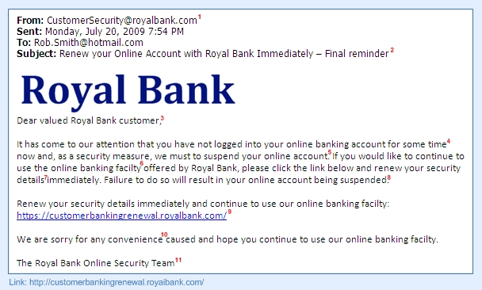
Example

Slide 12
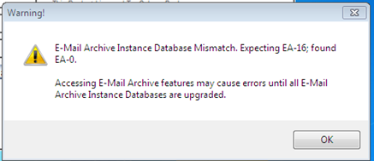
Example
Effective today a new version of Director has been launched. Users with out of date account security will receive the following error when trying to log in.
All users must accept the terms of the security policy and will be required to reset their password before March 1st. Any accounts that are not updated will be disabled.
Please use the link below to login to Director, accept the new security terms and update your account.
fiserv.abcbamk.com/update
Thank you,
Joe Jones
Network Analyst
315-123-4567 x4467 Phone
315-123-6789 Fax
jjones@abcbank.com
Main Office
1522 Main St., Utica, NY 13502
www.abcbank.com

Slide 13
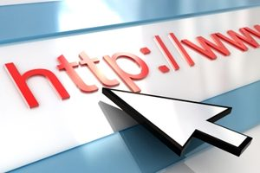
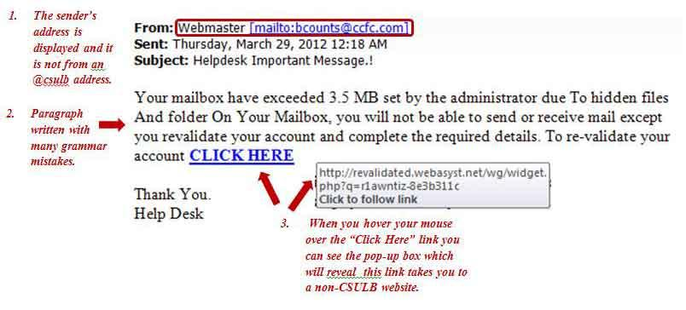
Precautions and Best Practices
Do not open emails if you do not know the sender
Do not click on links or attachments from unknown senders
Confirm the actual URL email is coming from before clicking on links or attachments
Mouse over link to verify and/or type in browser

Slide 14

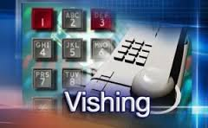
Vishing
VISHING
Phone Phishing to get pertinent information

Slide 15

Example
IRS Phone Scam

Slide 16
Example
Attacker: Hi, this is (use different name each time). I was just speaking to Michele in Deposit operations and she transferred me to you and she said you would be able to help me with the refer a friend promotion you have going on. I got this post card in the mail yesterday and (friend’s name) raves about ABC Bank and told me to sign up for your checking and use her as a referral, so we both can get the $25.
My friend (use customer names obtained from FB, switch up names, do not use same one on every call) referred me and gave me her account number, but they are telling me it is not complete and I need the complete number to do the refer a friend promo.
I have to go out of town tomorrow for a few days on a personal emergency. My mom just got admitted to the hospital and I really need to take care of this before I go! My friend just left for vacation to Mexico and doesn’t have cell service for me to call her. The 7 digit account number she gave me is 4110, but I need the last 3 digits. Can you help me with this? I need the last 3 numbers in her account to set up so she gets the $25 referral!

Slide 17
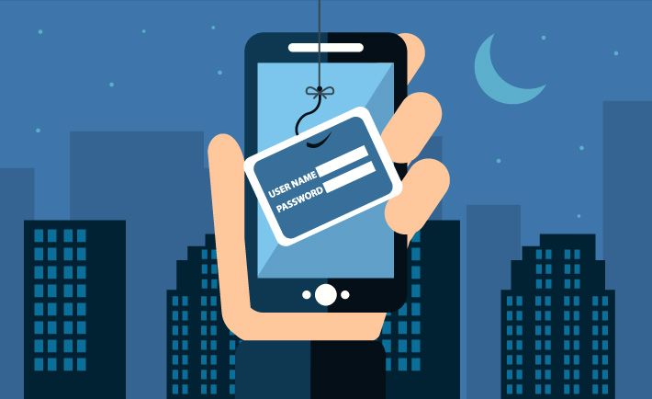
SMISHING
(SMS Phishing)

Slide 18
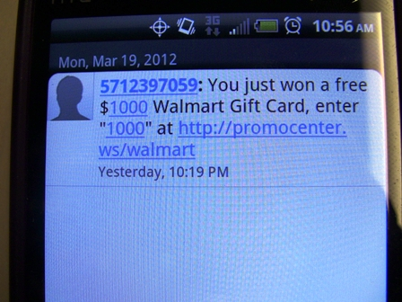
Example

Slide 19
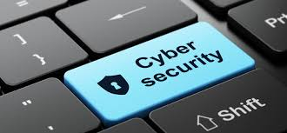
Precautions and Best Practices
Do not be enticed by text messages or emails offering prizes or giveaways
Be leery of phone scams or phone calls seeking customer or personal information
When in doubt, don’t proceed!!

Slide 20
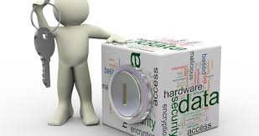
Current Social Engineering Scams
Invoice Phishing Scam
Microsoft Scam
Ransomware Phishing Attack
Tax Scam
BEC (Business Email Compromise) Scam

Slide 21
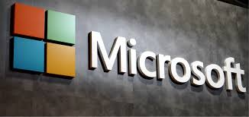
Microsoft Scam
Uses social engineering vishing or phishing to bait victim
Calls and poses as Microsoft, sends an email or message dialog box

Slide 22
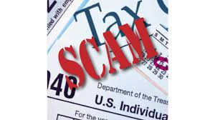
Tax Scams
Email social engineering attack
Phishing email contains a common ploy to trick the recipient into clicking on a link to download their W2 Form
In following example link went to a forged site for "MyADP"
account login credentials requested
Credentials entered into this page would be intercepted by the scammers and compromised

Slide 23
Example
To: xxxxxx@berkeley.edu(link sends e-mail) From: ADP PORTAL <director.stics@boyaca.gov.co(link sends e-mail)> Date: Tue, 24 Jan 2025 13:31:49 Subject: Update Portal The Human Resources/Payroll Department has completed the final paystub changes for 2025 tax year. To view the changes to your paystub information and view/download your W-2 forms (2023 - 2025 tax years), go to: Adp Portal We hope you find the changes to your paystub information useful and welcome any comments you may have. Yours Sincerely, Danielle Carrel.
Original Message:

Slide 24
Rise in Ransomware Attacks
Ransomware attacks increased 58% in 2025
Ransomware attacks have increased in the ease, speed, and profitability of victimization

Slide 25
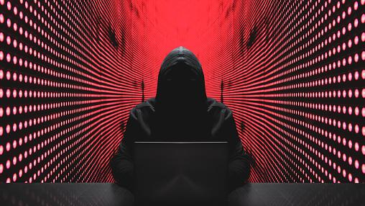
RANSOMWARE
Ransomware is a malware designed to deny a user or organization access to files on their computer by encrypting these files and demanding a ransom payment for the decryption key
The most common way malicious actors deploy ransomware is via phishing emails
The ransom payment will often by requested in the form of a cryptocurrency
Notes:
Ransomware is becoming one of the most widely used malware that is affecting more and more companies each year. This is because it is much harder to hold someone accountable for a ransomware attack when compared to other types of malware.
In recent years, ransomware has become kind of like its own sector of business. These malicious actors perpetrating these attacks want users to go to their onion sites and haggle with them. They feel justified doing this in a way, they think of themselves as good people bringing down huge corporations.
Ransomware works by denying a user or organization access to files on their computer or network by encrypting them and requiring the organization to send a ransom payment to get them back.
The ransom payment is normally requested in some form of cryptocurrency like bitcoin.
Ransomware is most commonly deployed using phishing emails just like other forms of malware.
In certain circumstances, like ransomware attacks, it is more important to get off the network then to power down your computer, preserving digital evidence is pivotal.
If you suspect your computer or network is being targeted by ransomware, you and your organization should immediately contact a cybersecurity vendor or IT vendor. The next steps to handle this attack will be determined by them.

Slide 26
REAL LIFE RANSOMWARE
Notes:
We are now going to go over a real life example of a ransomware attack, what it can look like and what exactly it will do to your organization.

Slide 27

MGM Grand Ransomware Attack
Ransomware attack September 2023
Found an employee’s information on LinkedIn then impersonated them to get login credentials from IT.
Affected many of MGM's systems.
Customer’s personal information may be affected
Cost MGM upwards of $80 million
Lasted 10 days
Notes:
A very recent example of a ransomware attack happened in September of 2023 and was done against MGM Grand.
This attack was done by a hacking group that found the LinkedIn of one of the employees and used this to impersonate them then contacted the IT help desk.
They were able to get this employees login information.
Affected systems handling resort services, dining, entertainment, pools, and spas.
could not guarantee that personal information about tens of millions of customers, including driver’s licenses and Social Security numbers of loyalty rewards members, had not been compromised.
This cyber attack caused over 80 million dollars in damages to MGM and lasted 10 days.

Slide 28
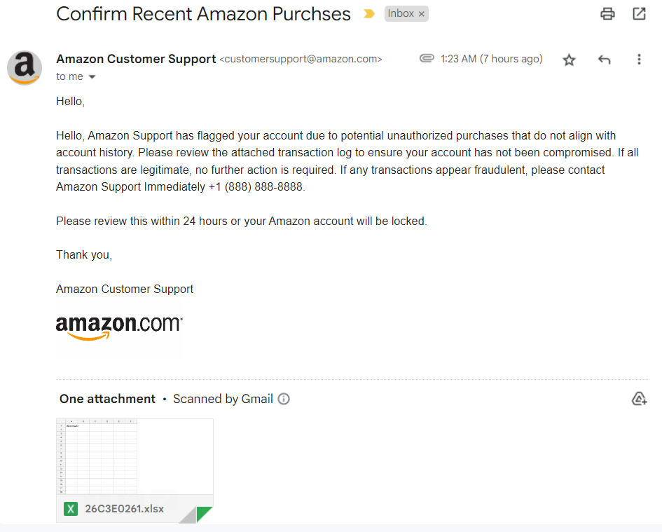
Notes:
This email is an example of a phishing email that can be used to deploy ransomware to your organization.
As you can see, it has all the common identifying factors of a phishing email we went over.
It has a general greeting
A sense of urgency by saying you need to open and review this document within 24 hours or your Amazon account will be locked.
And a suspicious attachment, which in this example is an excel document that has a suspicious sounding name.

Slide 29
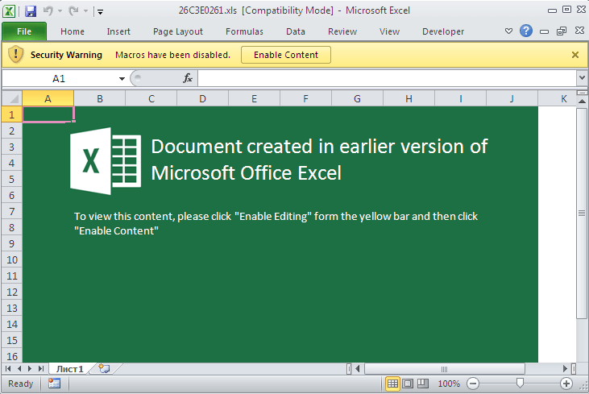
Notes:
Once this excel document is open, you may see something like in this image. It is trying to get the user to enable the content which will then enable macros. These macros will then automatically run once you enable it which will then deploy some kind of malicious code to your computer.

Slide 30
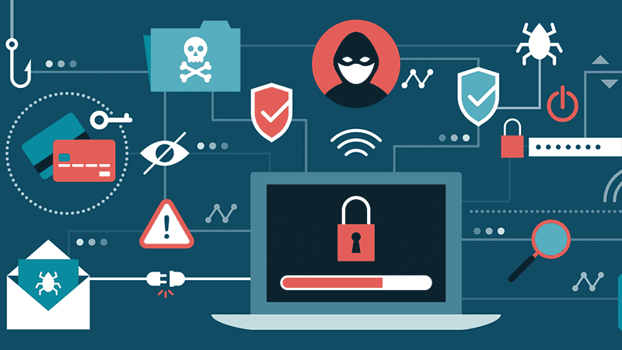
A MALICIOUS ACTOR’S TOOLBOX
Credential Harvesters
  A tool that is used to steal login credentials by tricking a target into entering them on a fake website.
  Deployed via phishing emails
Malware can be used to:
  Spy on a user’s activity (emails, file surfing, etc.)
  Exfiltrate data
  Launch a Ransomware Attack
Notes:
Malicious actors have many different tools they can use to exploit you and your organization.
One of these tools is called a credential harvester, which does exactly what the name suggests. It is a fake website that will coerce you into entering your login credentials which can be seen and stolen by the malicious actor.
Credential harvesters are usually included in a phishing email.
Malware is also deployed via phishing email and can wreak havoc on an organization.
Malware can affect an organization in many ways, like spying on user activity, exfiltrating data from the company, or launching other attacks such as ransomware.

Slide 31
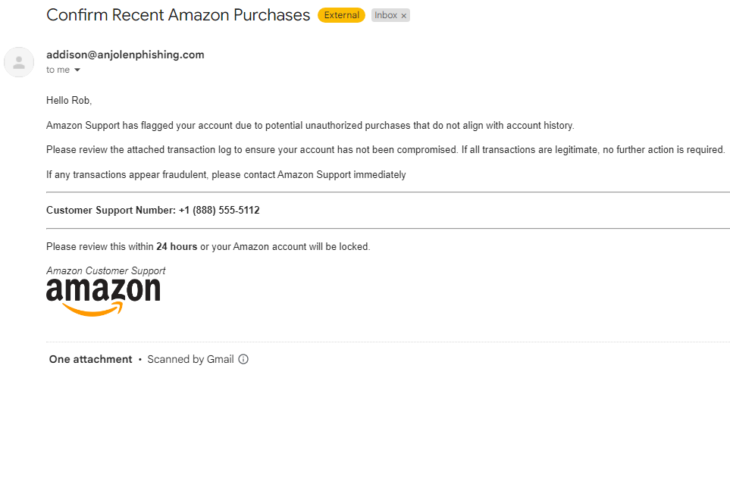

Copyright – All rights reserved. Anjolen 12/14/2023
Notes:
Provided here is another email, can anyone determine if this is a phishing email?
There are a few factors here that show this is a phishing email. First the sender’s email address is not what you would expect from an email from Amazon. It is important to always check the senders address as most phishing emails will come from a suspicious address. Next, you will see that this email gives a time constraint, saying that if you do not act within 24 hours, your amazon account will be locked. This is commonly seen in phishing emails and is there to try and scare you into interacting with the email. Lastly, you will see this email has a suspicious attachment. You will want to make sure you only open attachments on emails that you are expecting or from a known email address. Lets click this attachment here and see what it brings up. Oh no, clicking this attachment seems to have installed a virus on my computer!

Slide 32
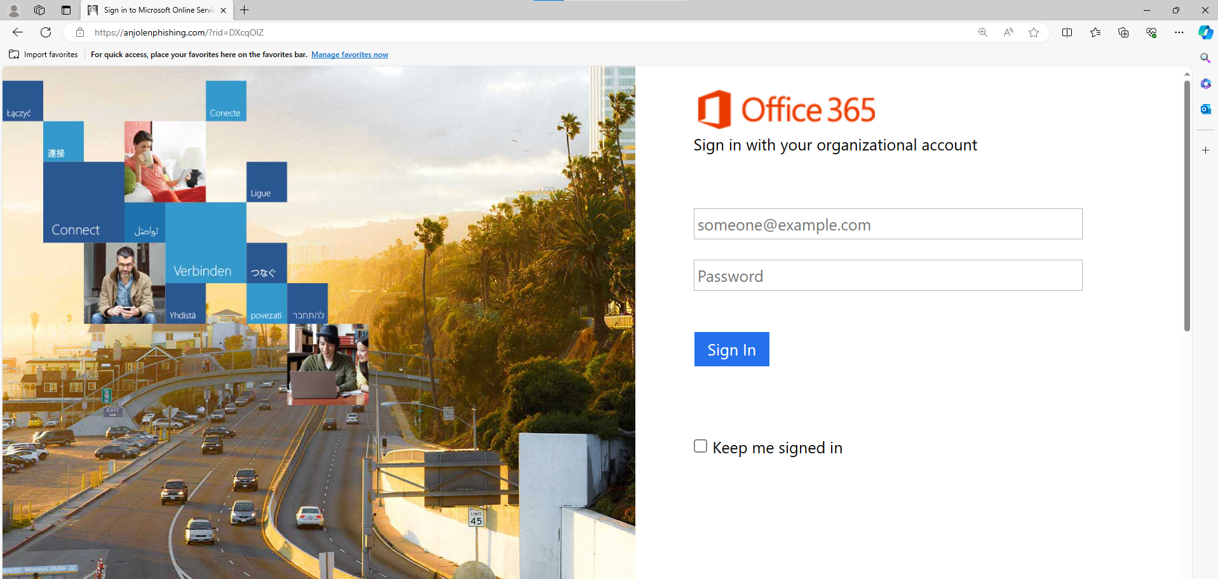
Copyright – All rights reserved. Anjolen 12/14/2023
Notes:
The malicious actor who gained access to this organization created a mail rule in one of the employee’s inbox. This mail rule made it so anyone who responded to the phishing email they were sending from this address would go to a different folder they created instead of the main inbox. They did this to try and avoid detection by the actual owner of the email.

Slide 33
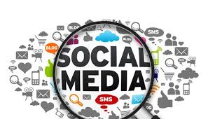
Open Source Intelligence
Definition Review
Definition: Information collected from publicly available sources

Slide 34
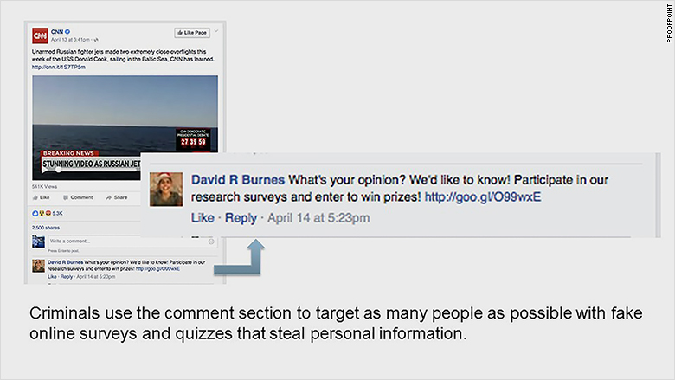
Open Source Intelligence Attack Examples
Fake online surveys and contests designed
to get answers to personal questions

Slide 35
Precautions and Best Practices
Do not open emails if you do not know the sender
Do not click on links or attachments from unknown senders
Confirm where the actual URL email is coming from before clicking on links or attachments
Confirm actual Twitter account for legitimacy, before providing info
Do not be enticed by text messages or emails offering prizes or giveaways
Be leery of phone scams or phone calls
seeking customer or personal information
When in doubt, don’t proceed!!

Slide 36
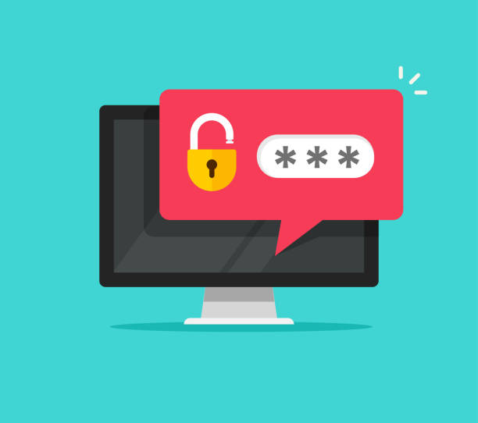
PASSWORD HYGIENE
Create strong passwords:
  Length > Complexity
  Alphanumeric swaps are your friend (1 = I, o = 0)
  Symbols can replace letters (a = @, s = $)
Do not write down passwords
Do not reuse passwords or use it for multiple accounts or applications
Use a secure password storage solution for all passwords
Multifactor Authentication
Phone, Token, FOB
Notes:
Practicing good password hygiene will help to better protect your organization.
Length is extremely important for your password, it is better to prioritize this when creating your password over the complexity. A long password has more different combinations of characters which would make it much harder for a malicious actor to crack your password.
Alphanumeric swaps can be a great way to make your password more secure, this includes swapping letters like an I for a 1, or an O for a 0, symbols can also be used to replace letters such as swapping an A for the @ symbol or an S for a $.
You should never write down your passwords in any way, this can be easily obtained by prying eyes if you leave this written at your desk.
Your password should never be reused for multiple accounts or applications, always try and make different secure passwords for all accounts.
If you have a hard time remembering all your passwords, you can use a password storage solution which requires you to only remember one passwords to have access to all your accounts.
Multifactor authentication is one of the best ways to secure account, this involves using an external device or object to secure your account, such as requiring it to send a text to your phone to log in or use a FOB device to sign in.

Slide 37
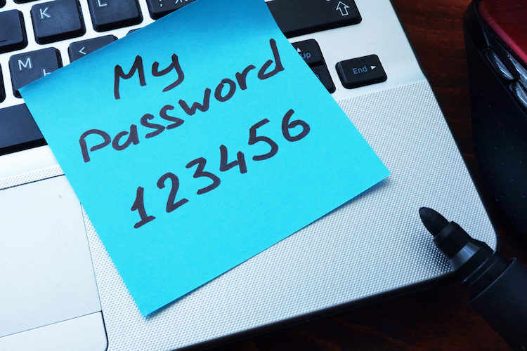
WEAK PASSWORDS
Passwords should not contain personally identifiable information
  Name, Address, Birthday, etc.
Should not contain easily guessable words
Weak password examples
  Password123, Mark1997
Copyright – All rights reserved. Anjolen 12/14/2023
Notes:
Your password is one of the first lines of defense against malicious actors, as such you should know how to create a strong secure password.
It should never contain any personal information about you such as your name, address, or people you know. This information can easily be found on social media if a malicious actor was to do an open source intelligence investigation.
It should also not contain any simple or easily guessable words.
Some examples of weak passwords are Password123, or Mark1997

Slide 38
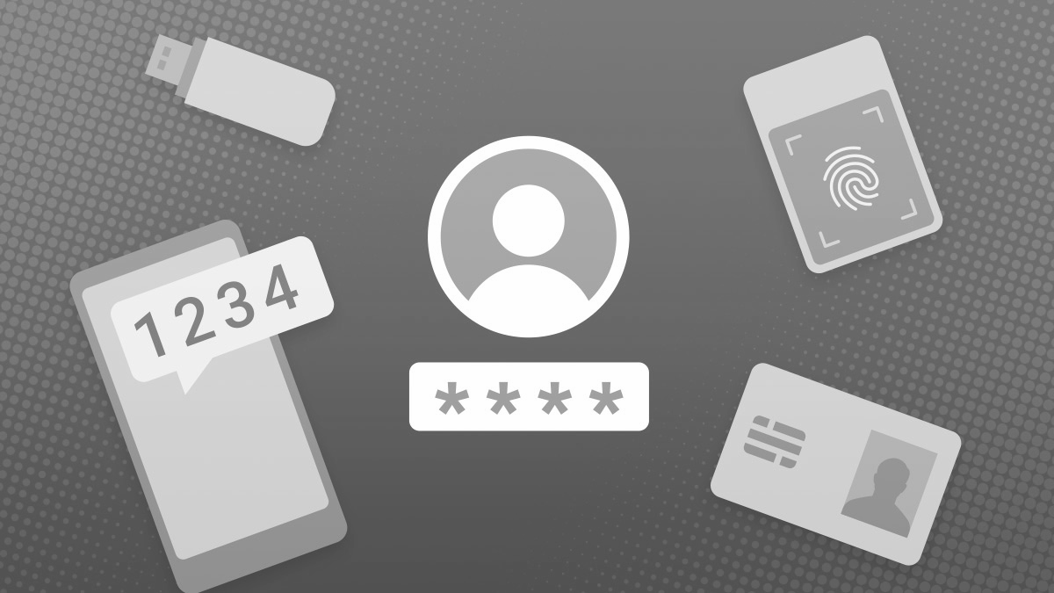
MULTIFACTOR AUTHENTICATION
Definition: An authentication system that requires more than one distinct authentication factor for successful authentication. Multi-factor authentication can be performed using a multi-factor authenticator or by a combination of authenticators that provide different factors. The three authentication factors are something you know, something you have, and something you are.
Something you know: Password/Pin #, etc.
Something you have: Token/keycard, supplied Pin, etc.
Something you are: Fingerprint/retina scan, etc.
Notes:
Multifactor authentication is another great way to thwart potential account compromises.
Some applications offer multifactor authentication, it just needs to be enabled, some require it.
Multifactor authentication includes three authentication factors, which are something you know, something you have, and something you are.
Something you know would be something such as a password or a PIN
Something you have is a token or a keycard or a pin that is supplied by your organization
Lastly, something you are includes your fingerprint or a retina scan.
Combining authentication factors ensures that if someone has access to your password, they still will not be able to get into your account.

Slide 39



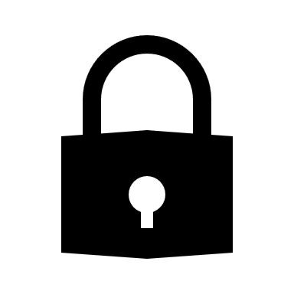
EMAIL SECURITY
Never click on links in emails that you are not expecting
Do not download email attachments unless you are expecting the email and attachment
If in doubt, reach out to the sender via phone call or in-person to verify the email
Use email encryption solutions when sending sensitive data
Notes:
When you get your authentication, all squared away, you still need to be mindful of security.
Remember, over 90% of malware is delivered via email.
Never click on email attachments unless you are 100% sure they are legitimate, and even then, you should still be skeptical.
It is always a good idea to confirm with the sender via phone call or in person.
Sensitive data should never be sent in plaintext, it should always be encrypted.

Slide 40
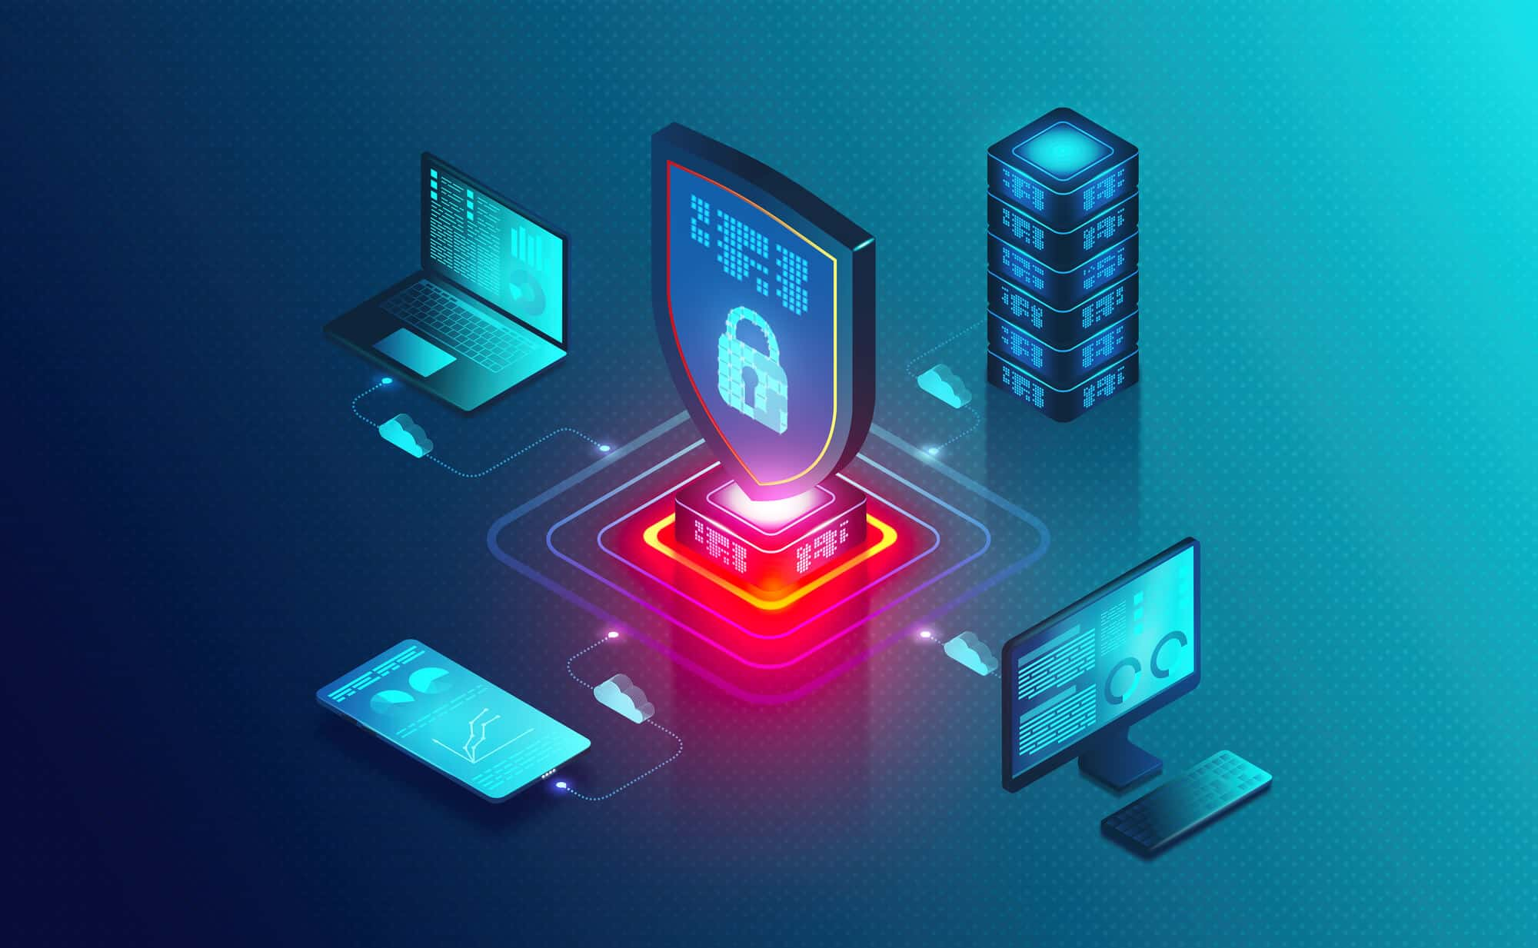
RECAP
CIA Triad
  Confidentiality, Availability, Integrity
Human Vulnerability
  Humans are the most vulnerable link in an organization
Phishing
  Know how to identify a phishing email
Malware
  Deployed using phishing emails
Passwords
Ransomware
Notes:
Let’s recap quickly what we have gone over in this training.
First the CIA triad, it is important to know what this stands for and how it helps protect your information.
Remember that humans are the biggest vulnerability in an organization, always ensure you are knowledgeable about cyber topics and what you can do to help your organization.
It is crucial to know what a phishing email is, how to identify one and what to do if you think you have interacted with one.
Malware can affect all organizations; it is good to be cognizant of this and do what you can to protect your organization from this by being aware of phishing emails and reporting any suspicious activity.
Practice good password hygiene, as we saw in the password cracking demo, you should always pick a long and secure password to prevent malicious actors from cracking it and gaining access to your accounts.
Lastly, ransomware is currently one of the most prevalent types of malware organizations are facing. As such, you should know the identifying factors of a ransomware attack and know what to do in the event of one.

Slide 41
THANK YOU!
Questions/Comments/Discussion
Notes:
Facilitate and encourage discussion.
Field all questions.
Thank you all, are there any questions about what we have gone over today?

