Slide 1
Off with the Apron On with the Hat
The Progressive Era and the Rise of
Women’s Organizations

Slide 2
In the three decades from 1890 to 1920 there existed a period known as the progressive era and it was in those years that America’s women came out of their kitchens and nurseries in great numbers and helped to shape the progress toward a better society within their own communities and the nation.

Slide 3
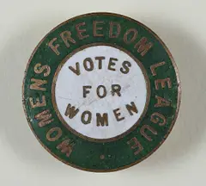
As most of us know, it was during this period when the women’s suffrage movement truly gained steam. The end of the era saw women casting their ballots in the General Election of 1920.
But there was so much more taking place in communities of every size across the country.

Slide 4
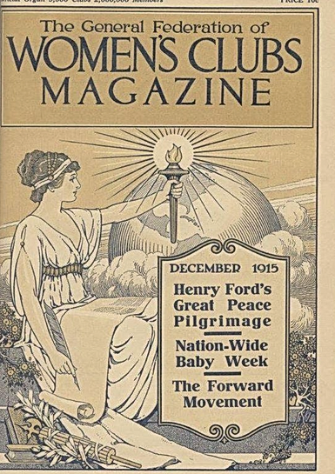
There were various women’s organizations which fell within the larger category of women’s clubs, but which should not be confused with the actual organization called the “Women’s Club”.
Called by many different names, but sharing a common genesis, these organizations organized around issues deemed important by the women who first called their friends and neighbors together.

Slide 5
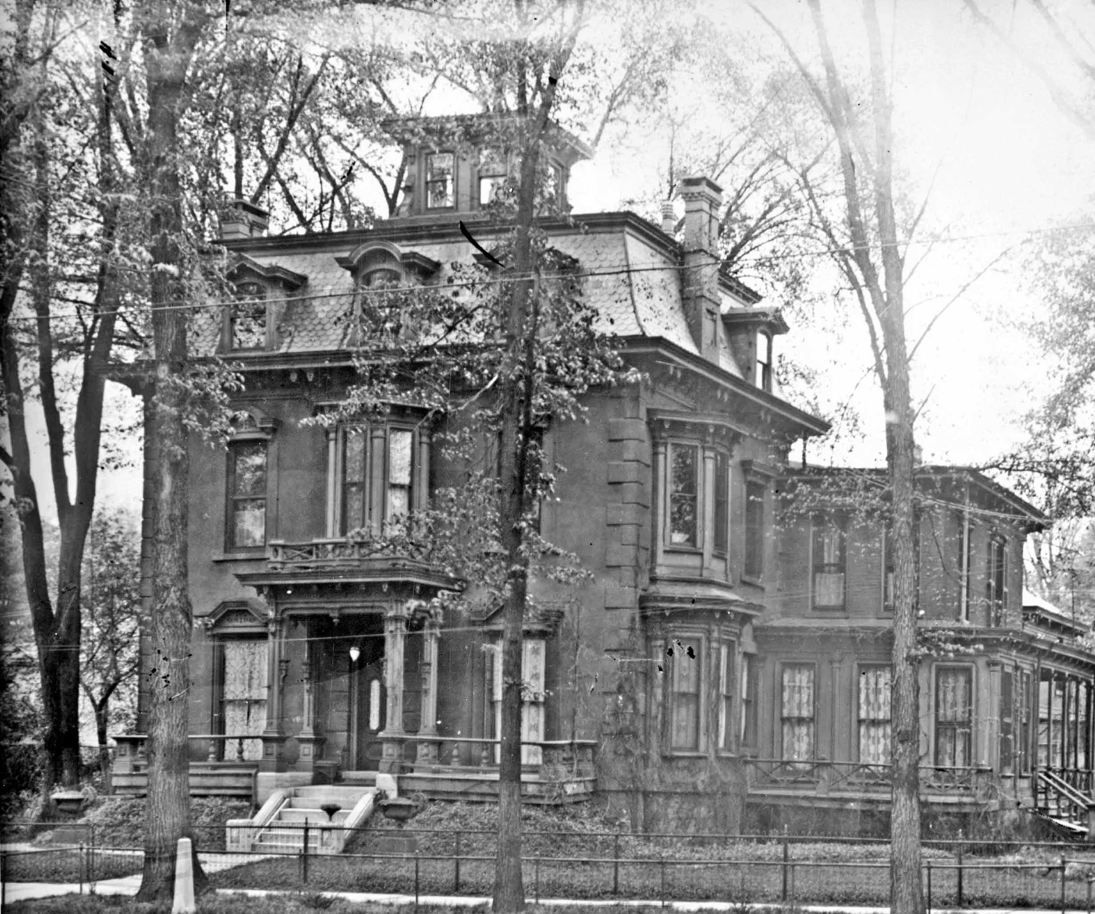
In Rome, NY, this notion of women claiming the public space which had been foreign to their mothers and grandmothers caught fire and produced one of the most socially beneficial periods in our community; as it did, too, within our nation.

Slide 6
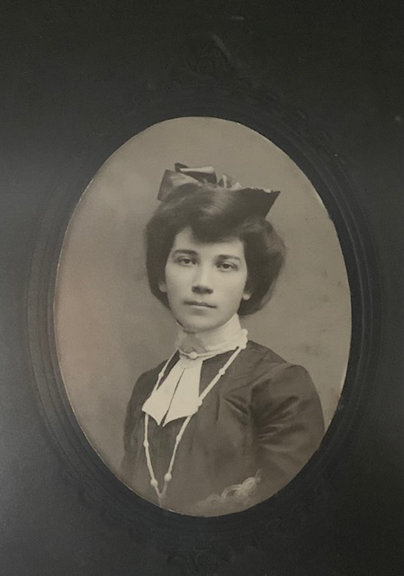
Together, we’ll look at four of the women’s organizations that flourished in the city at the conclusion of the 19th century and as the 20th came racing towards them.

Slide 7
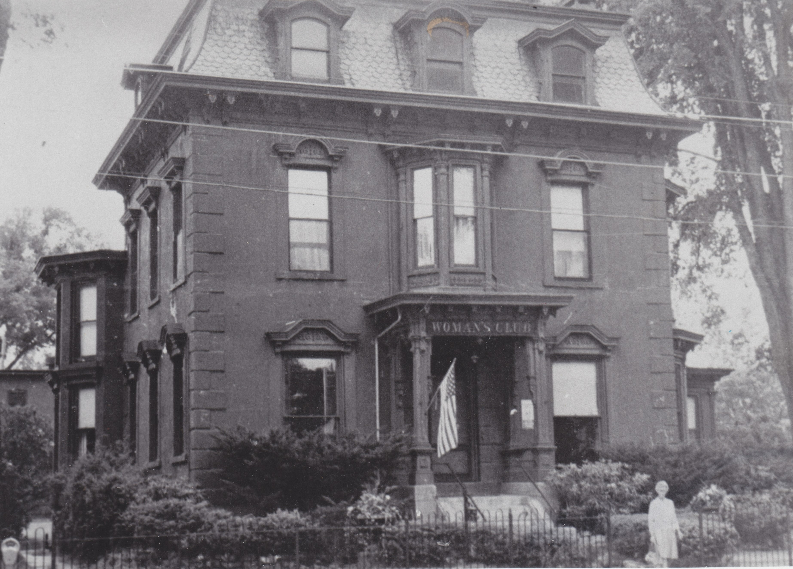
The Current Topic Club……1893
changed its name to the
Wednesday Morning Club ……1896
Fort Stanwix Chapter, DAR....1896
The Women’s Club .…1915
The Zonta Club ……1922

Slide 8
The Current Topics Club was formed to advance the knowledge and public speaking skills of its members. It provided a place for women’s intelligence to be displayed.

Slide 9
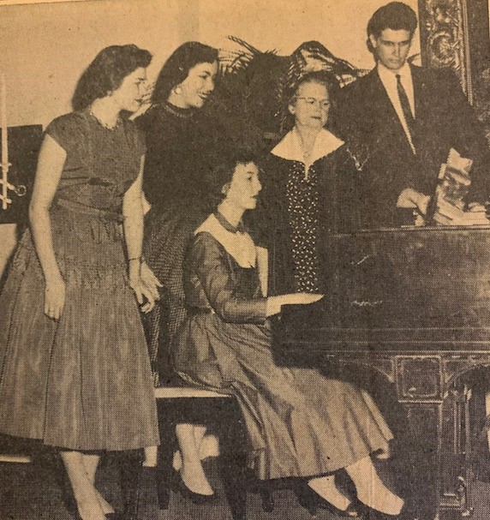
The programing enjoyed each Wednesday morning was designed to exercise the members’ abilities to present intellectual papers based upon areas of study. In 1900, a member presented her paper titled
“The status of the Jew in England during the Elizabethan Period”
.

Slide 10
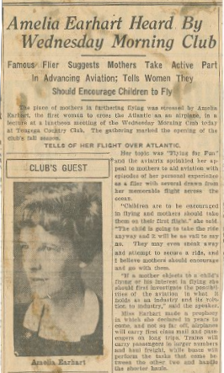
Amelia Earhart Heard By
Wednesday Morning Club
Famous flier suggests mothers take active part in advancing aviation; tells women they should encourage children to fly

Slide 11
The National Society Daughters of the American Revolution was founded on October 11, 1890 & incorporated by an Act of Congress in 1896

Slide 12
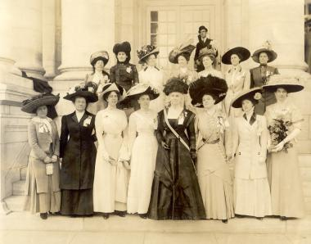
The DAR was founded on direct lineage to a Revolutionary War ancestor, but beyond that, its mission would be one of service to Home and Country

Slide 13
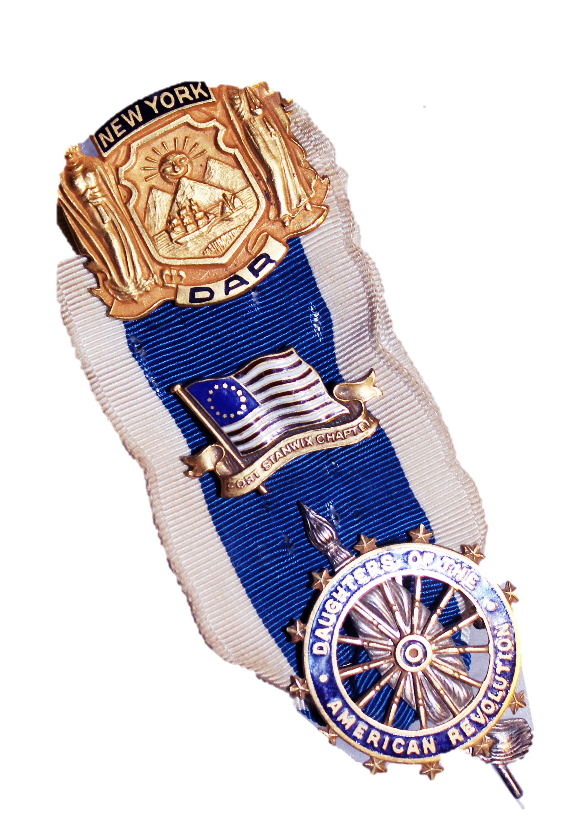
Fort Stanwix Chapter, NSDAR
Rome, NY
Organized January 13, 1896
Charter Granted June 19, 1896
Organizing Regent
Elizabeth R. Bright

Slide 14
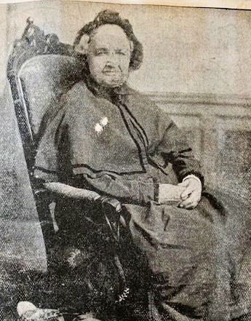
In 1896, when the Chapter was founded, there remained in our city a “real daughter” of the Revolution,. Her name was Polly Hubbard Vincent, and she was a charter member of the chapter. Polly was born in 1800 and died in Rome in 1899.

Slide 15
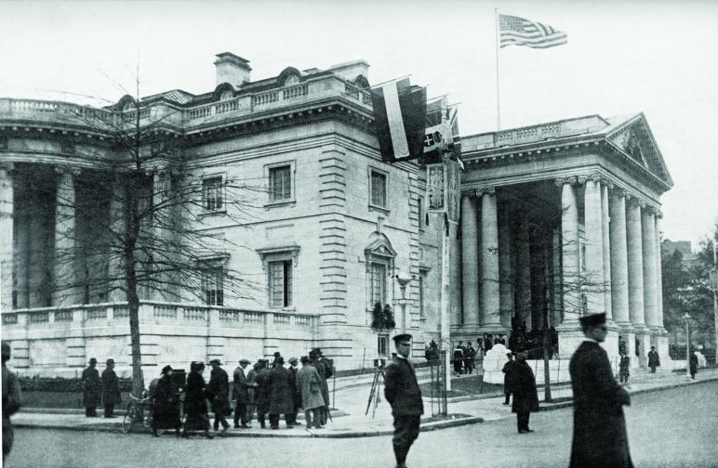
Historic Preservation Education Patriotism

Slide 16
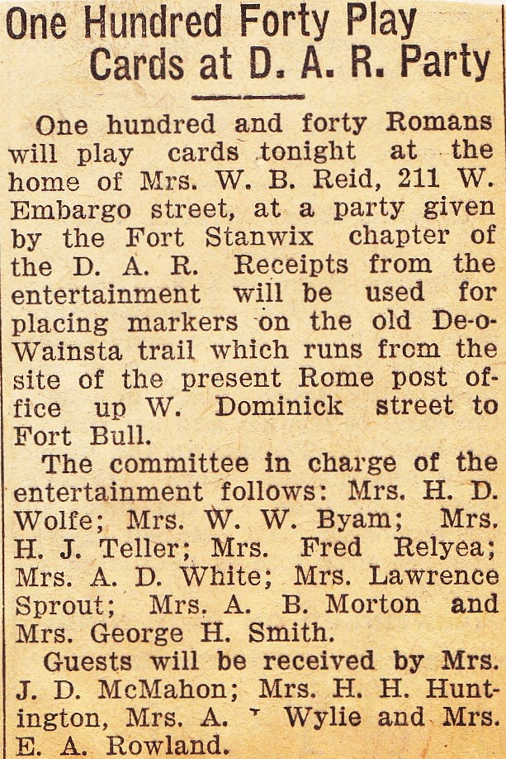
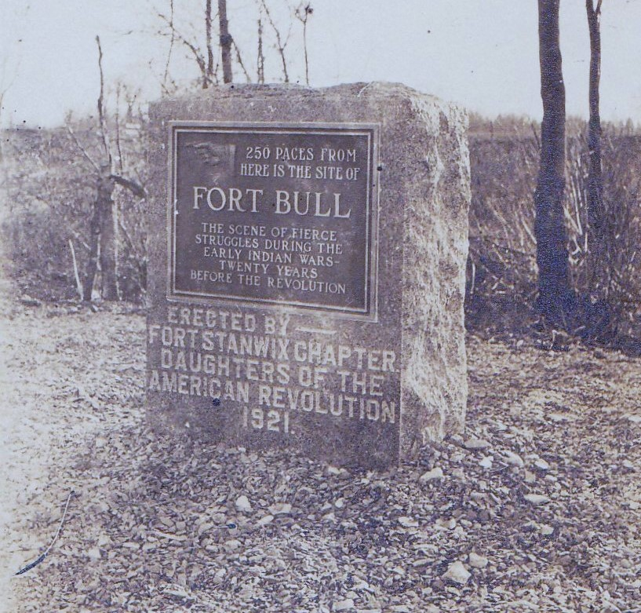

Slide 17
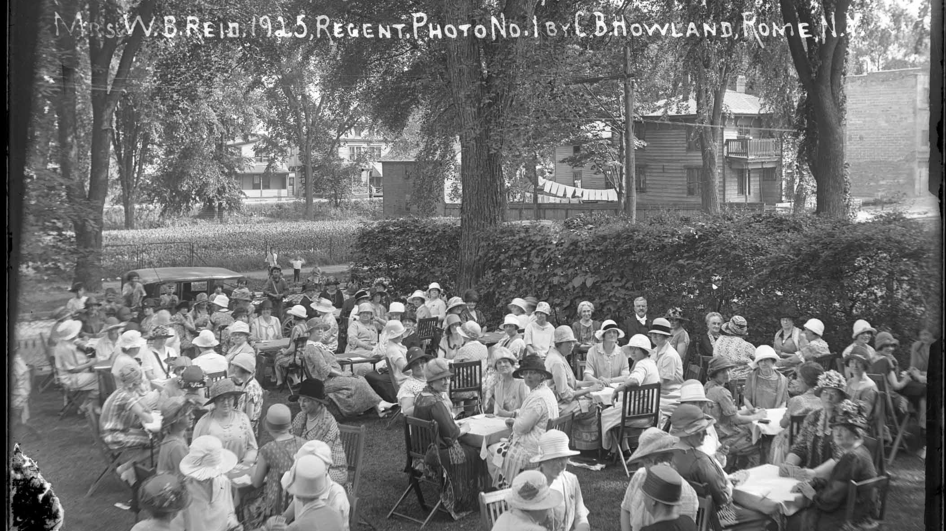

Slide 19
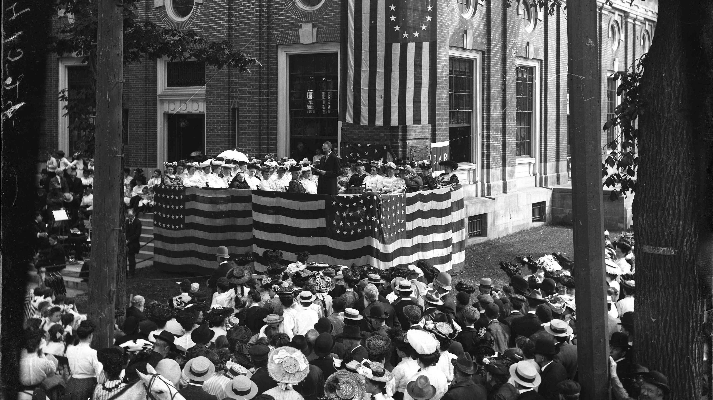

Slide 20
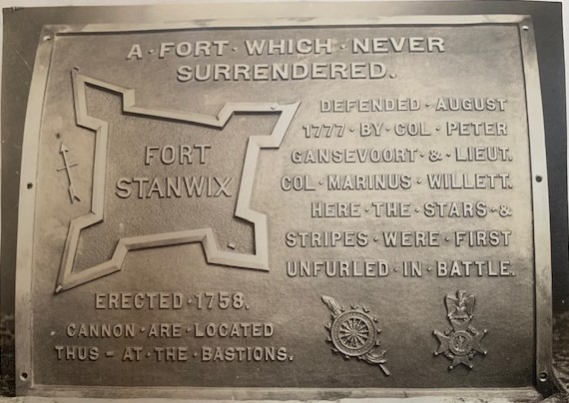
The Fort Stanwix Chapter along with the local Sons of the Revolution Chapter were instrumental in preserving and marking the locations of the four bastions of the original Fort Stanwix with gun carriages and cannon. Each carriage had attached, this bronze tablet.

Slide 21
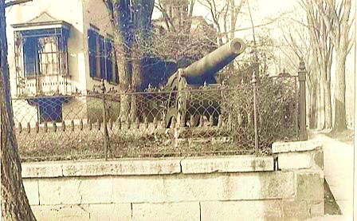

Slide 22
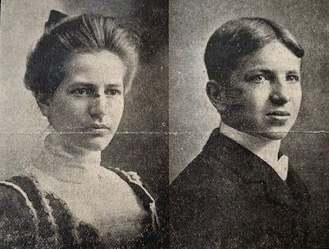
From its earliest days, Fort Stanwix Chapter awarded prizes to Rome students for essays written on historic subjects.
Miss Mary Humphreys
&
Arthur Keith
were recipients of gold eagles for their scholarship in writing on historic subjects.

Slide 23
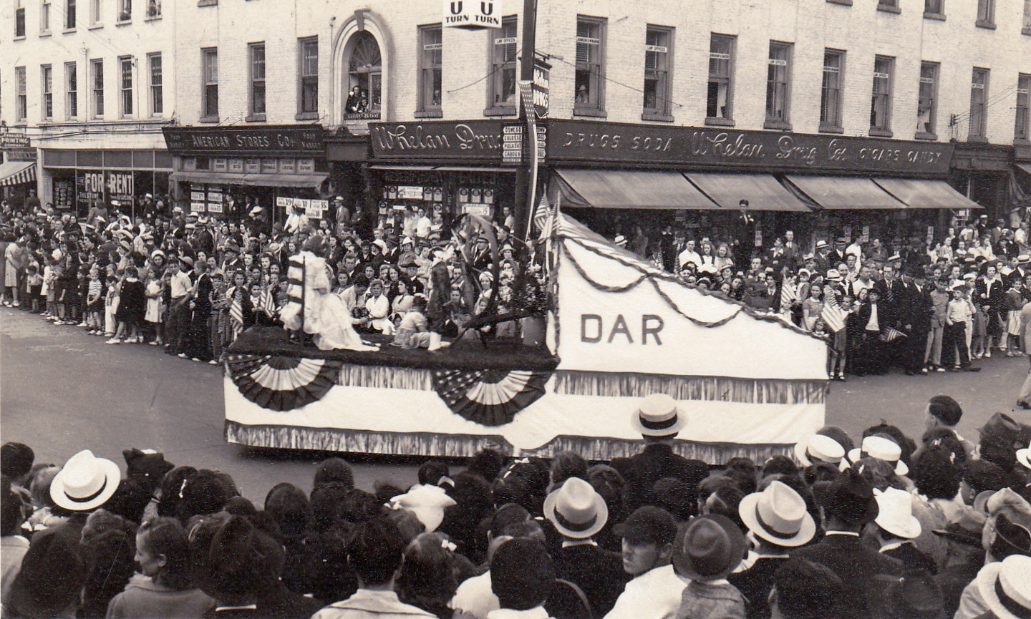

Slide 24
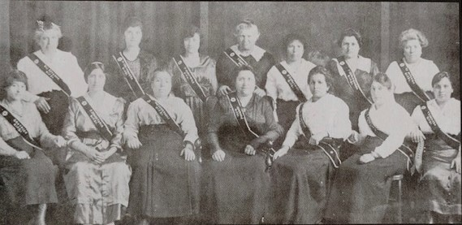
Society of Independent Children 1917-1918

Slide 25
The General Federation
of Women's’ Clubs
Founded in 1890 as a federation of many existing women’s clubs throughout the U.S.

Slide 26
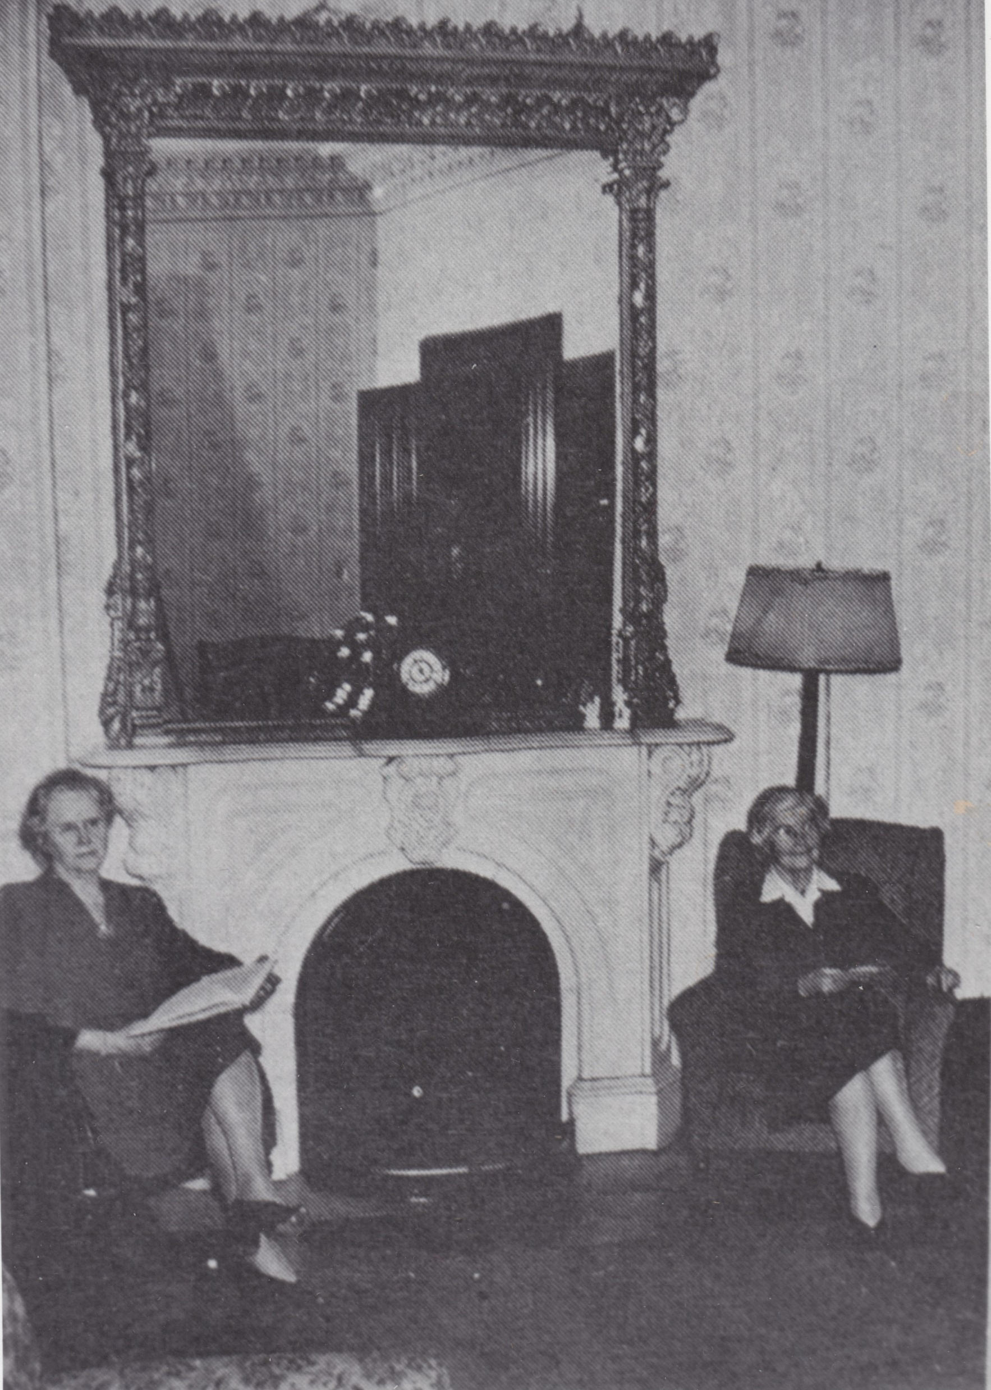
The Women’s Club of Rome held its first regular weekly meeting the evening of October 9, 1915
Its first home was Haselton Hall, 125 N. James St.
The Club found its permanent home in 1919 in the former home of Dr. and Mrs. Kingsley.

Slide 27
“Every woman of Rome has reason to love her hometown for what it gives to her and for what she can give to it.”
Miss M. Elizabeth Beach
“To Study and Serve”

Slide 28
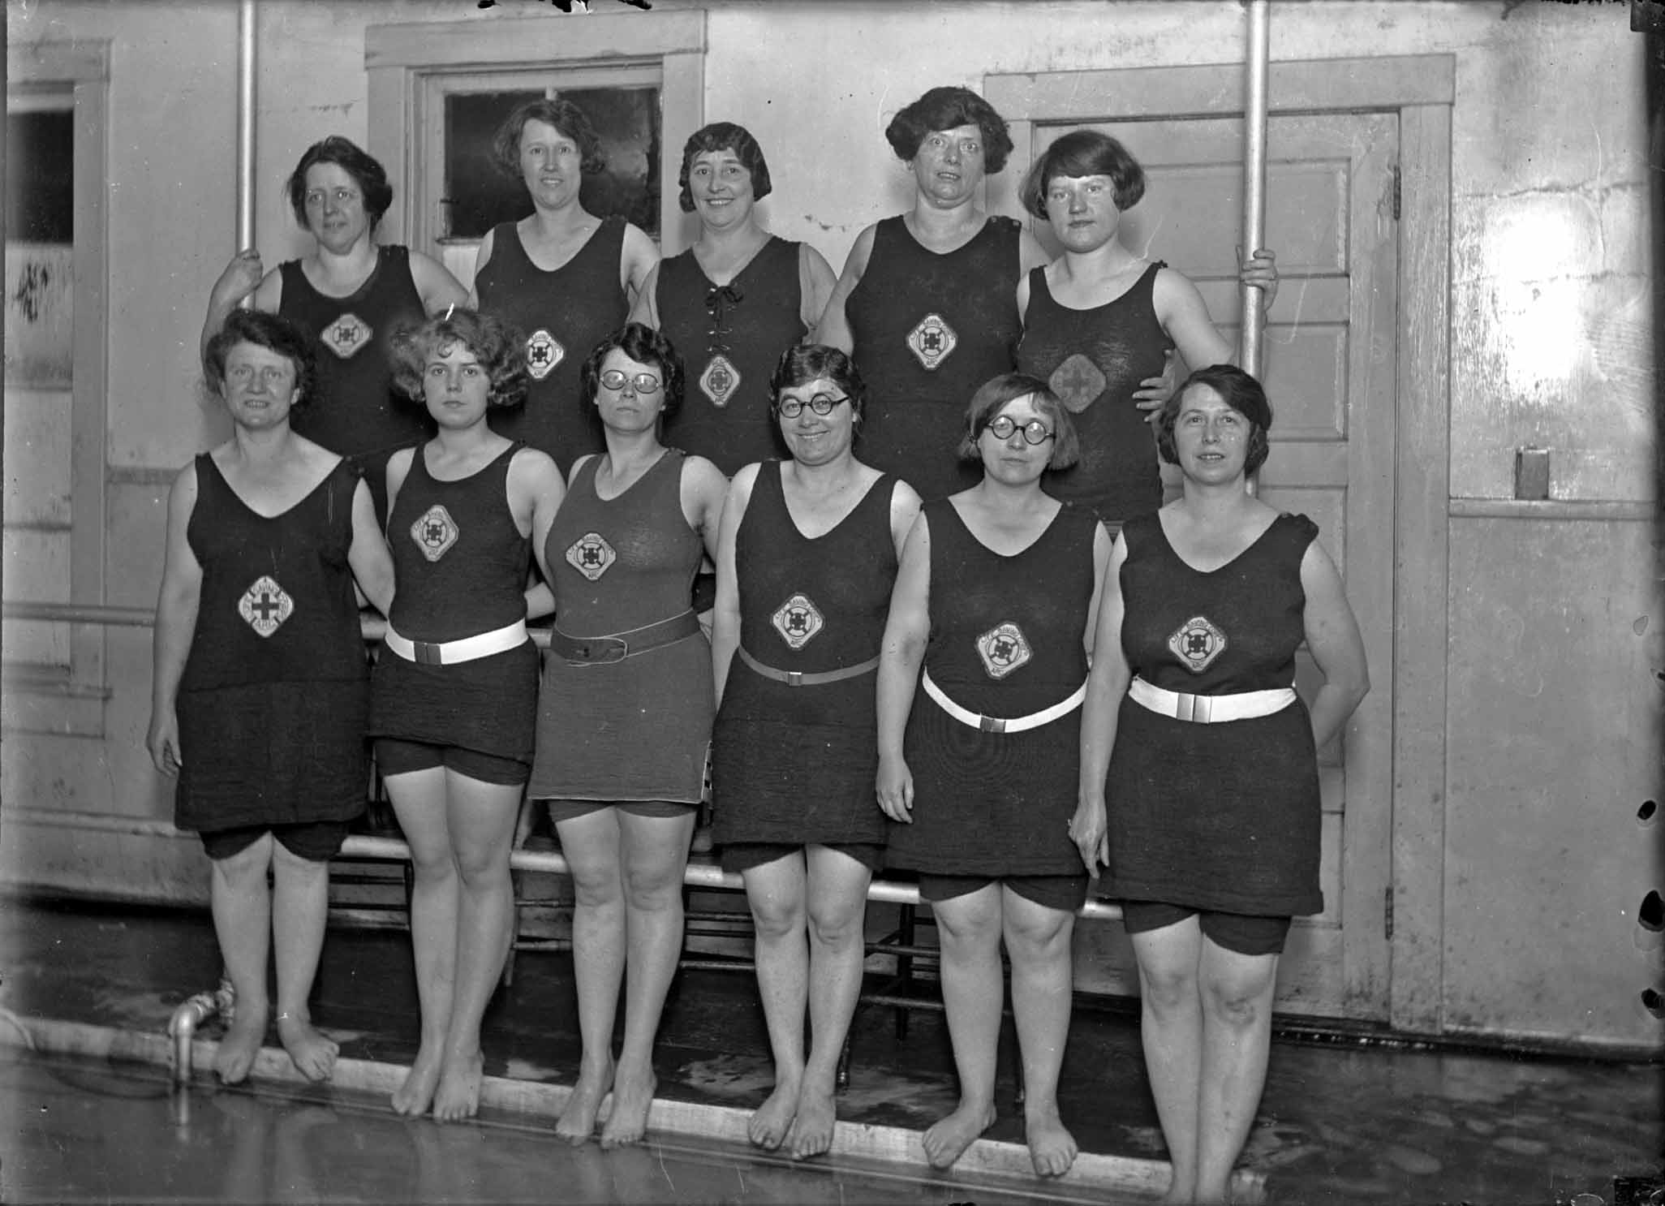
Physical fitness played
an important role in the club from the very start.

Slide 29
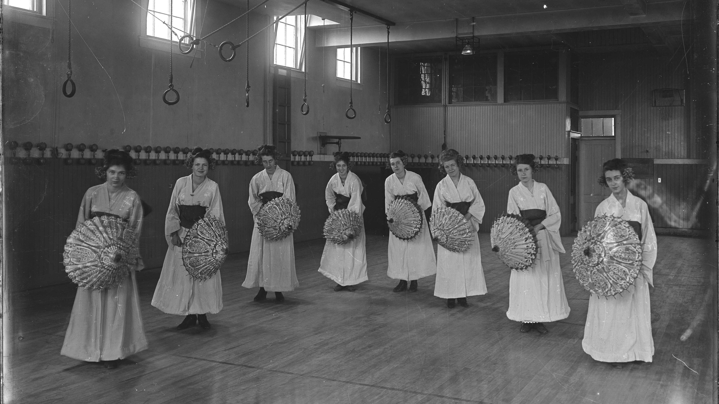

Slide 30
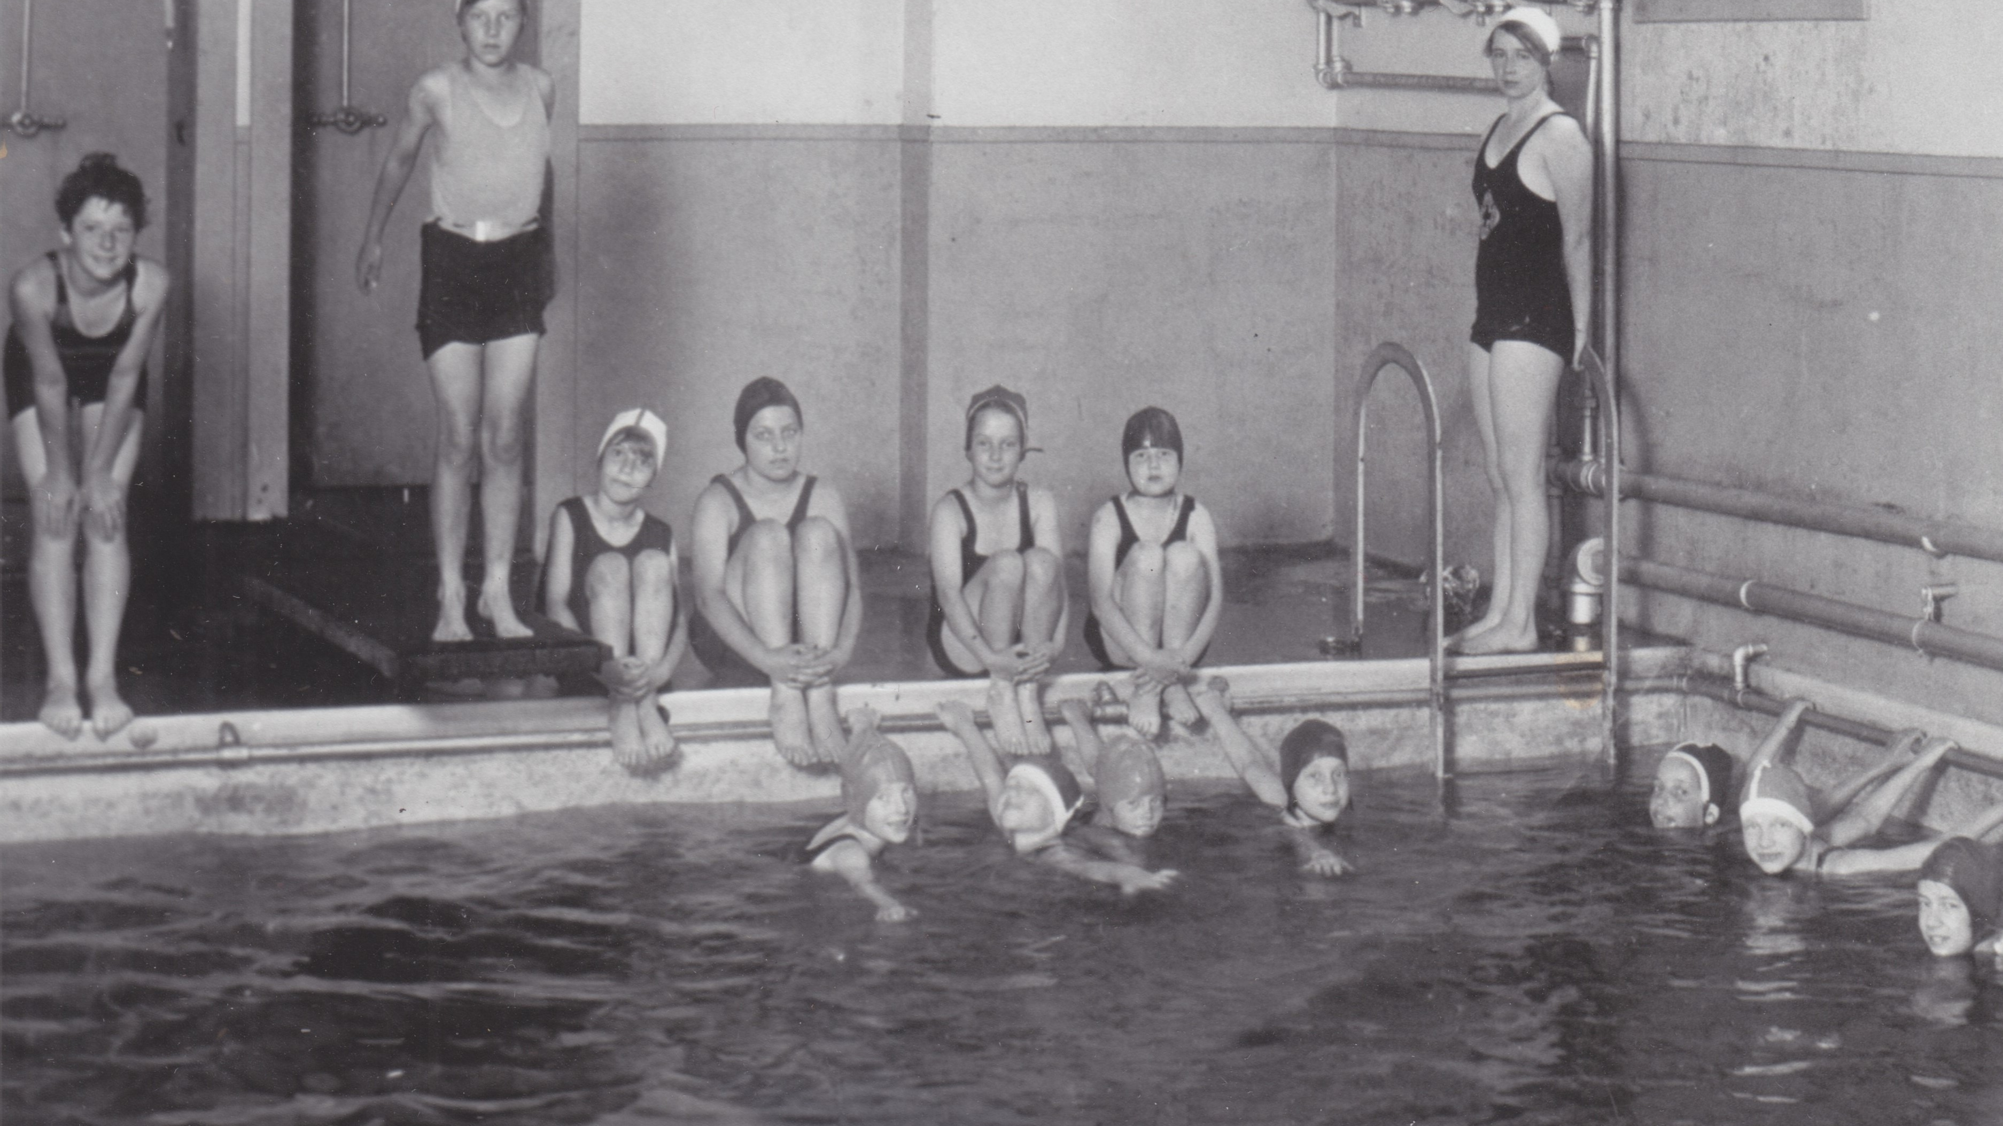

Slide 31
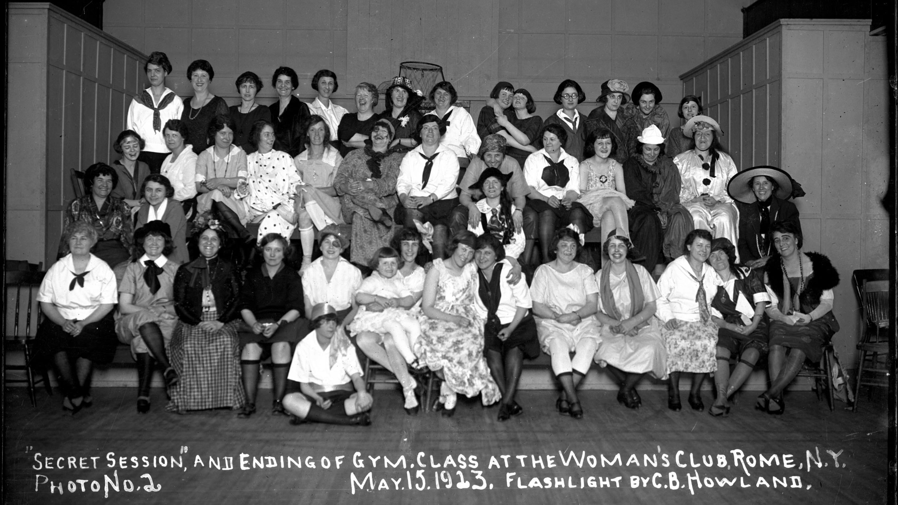

Slide 32
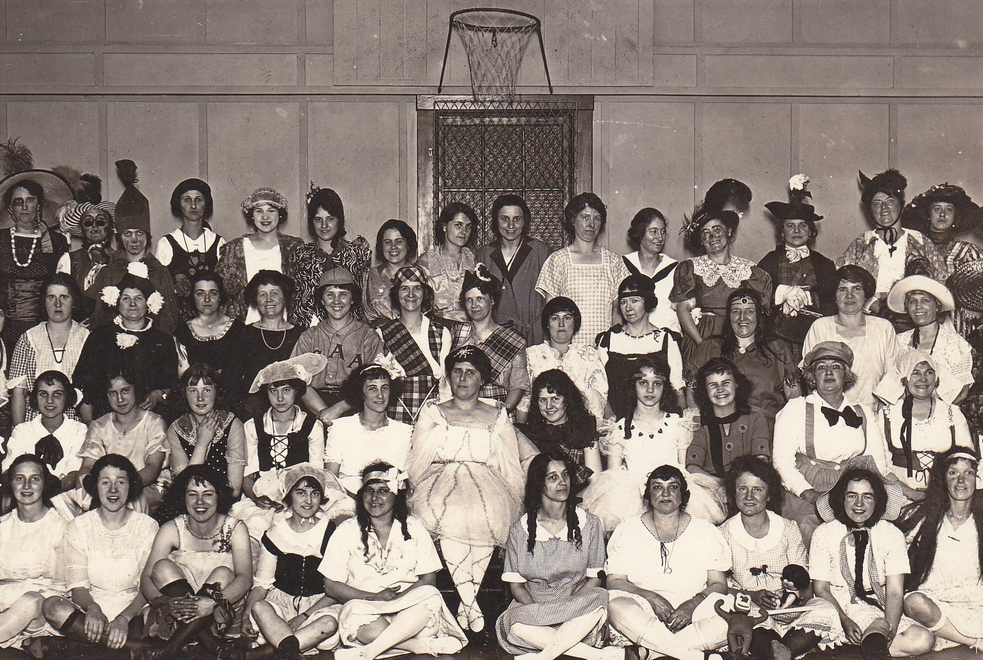
Costume parties were a joyful prospect at the conclusion of the Club’s fitness classes.

Slide 33
In 1960, the Club changed its name. In the future, it would be known as
The Women’s Community Center
of Rome

Slide 34
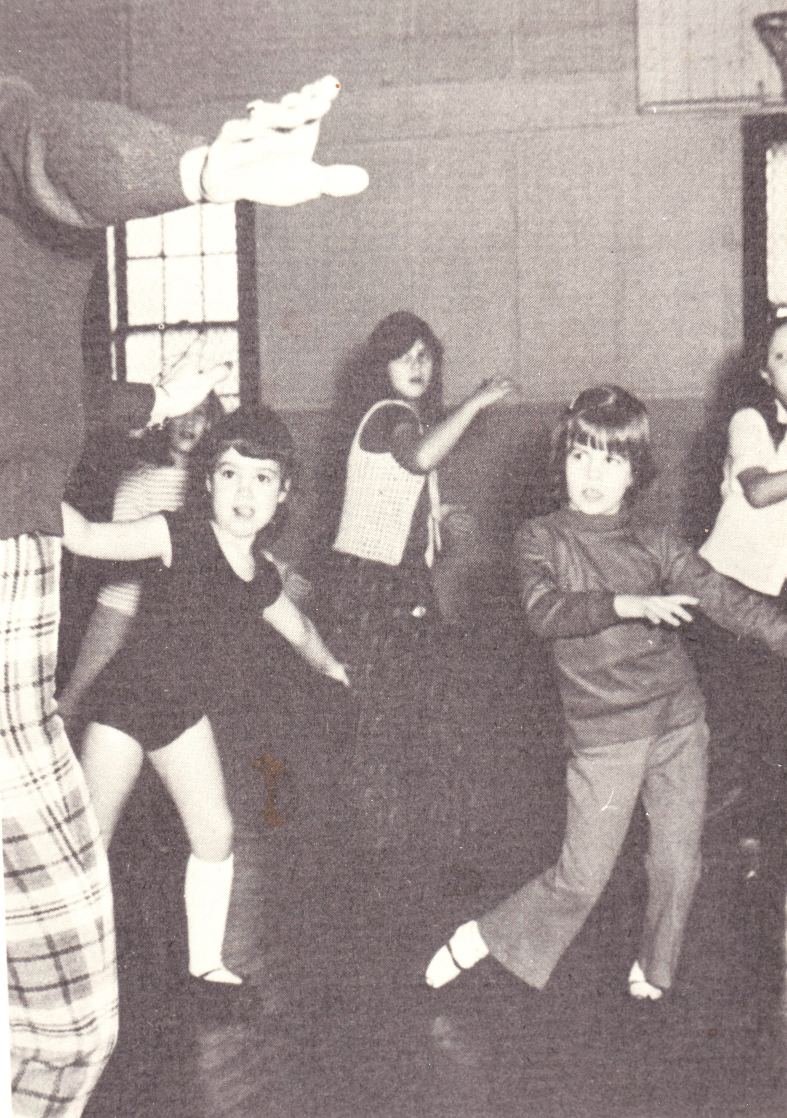
But just as it was in the past, dancing, swimming, physical training continued on as before.

Slide 35
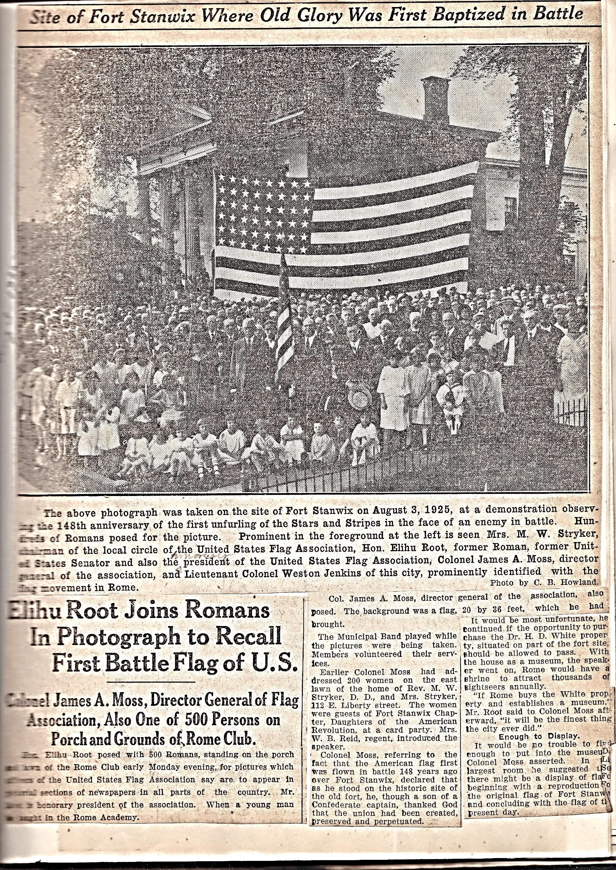
The Zonta Club was founded in 1922 as an organization to expand opportunities, through education, for girls and women.
The Club partnered with the US Flag Assn and was a sponsor of Rome’s US Flag Circle, active throughout 1925-26.

Slide 36
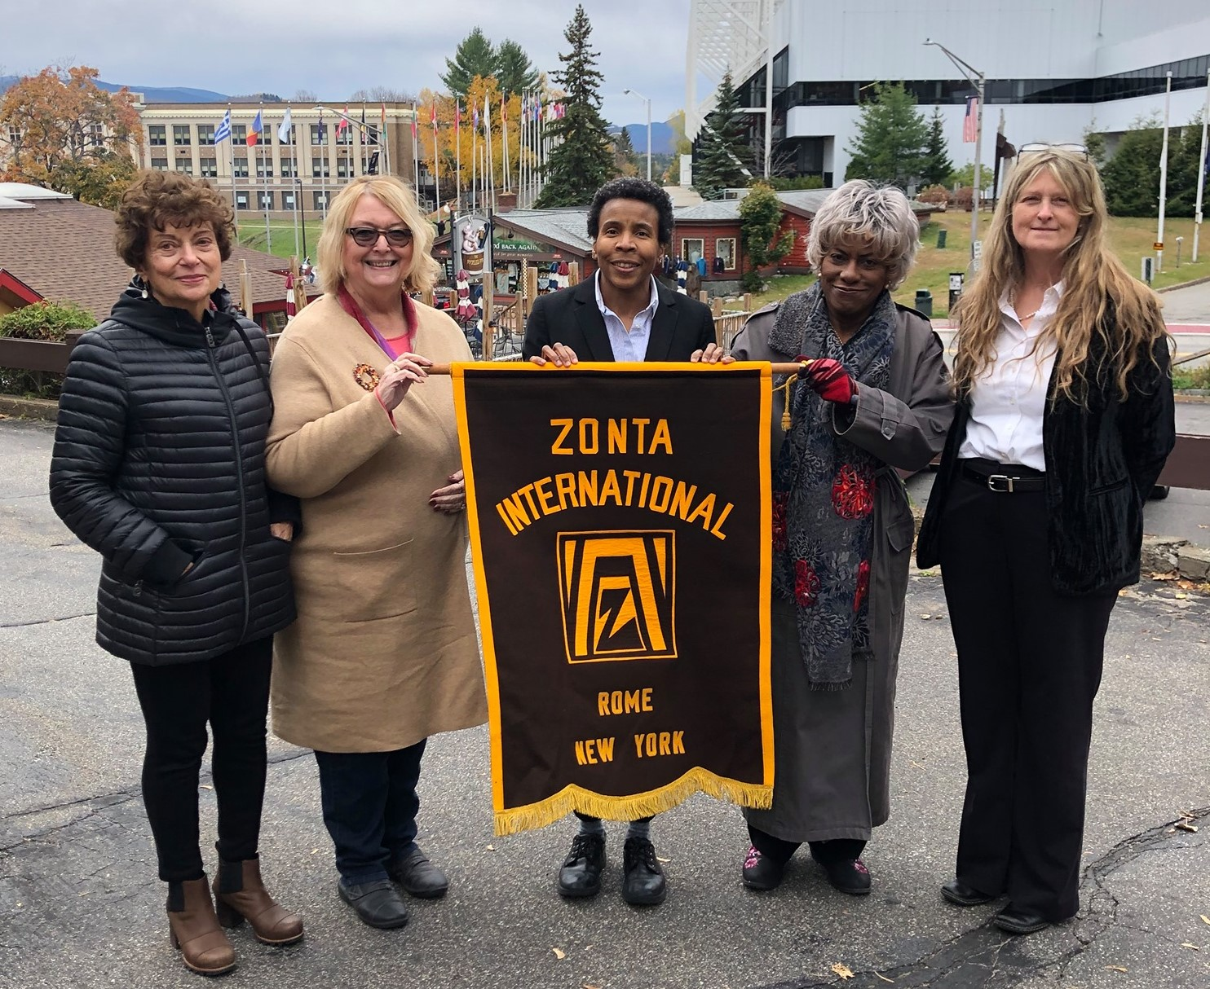
Today, Zonta has expanded internationally and has achieved consultive status as a Non-Governmental Agency with the United Nations.

Slide 37
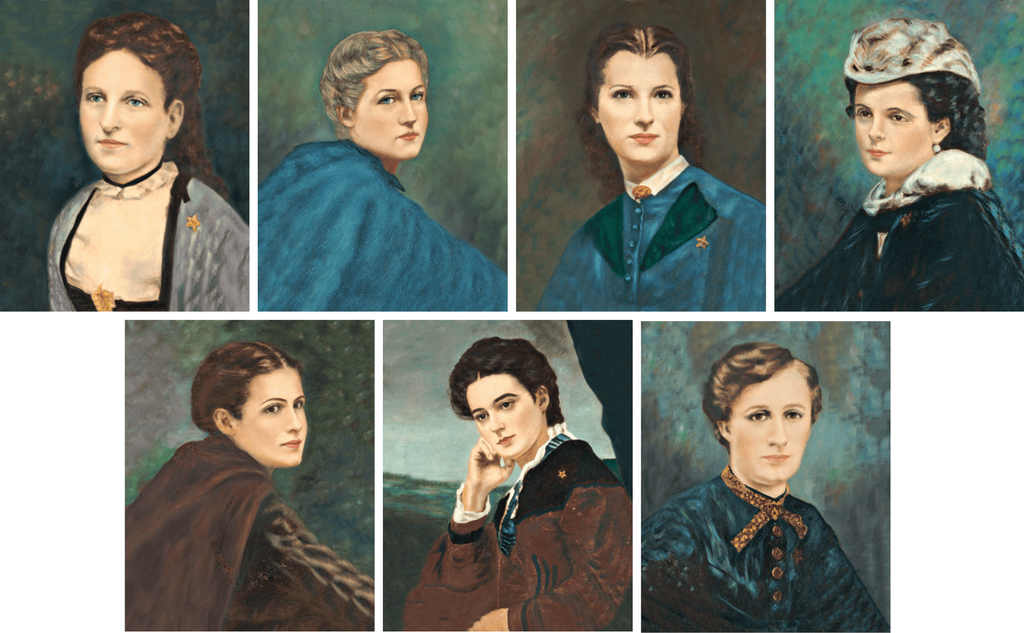
Philanthropic Educational Organization
Founded in 1869 by seven female students at Iowa Wesleyan College

Slide 38
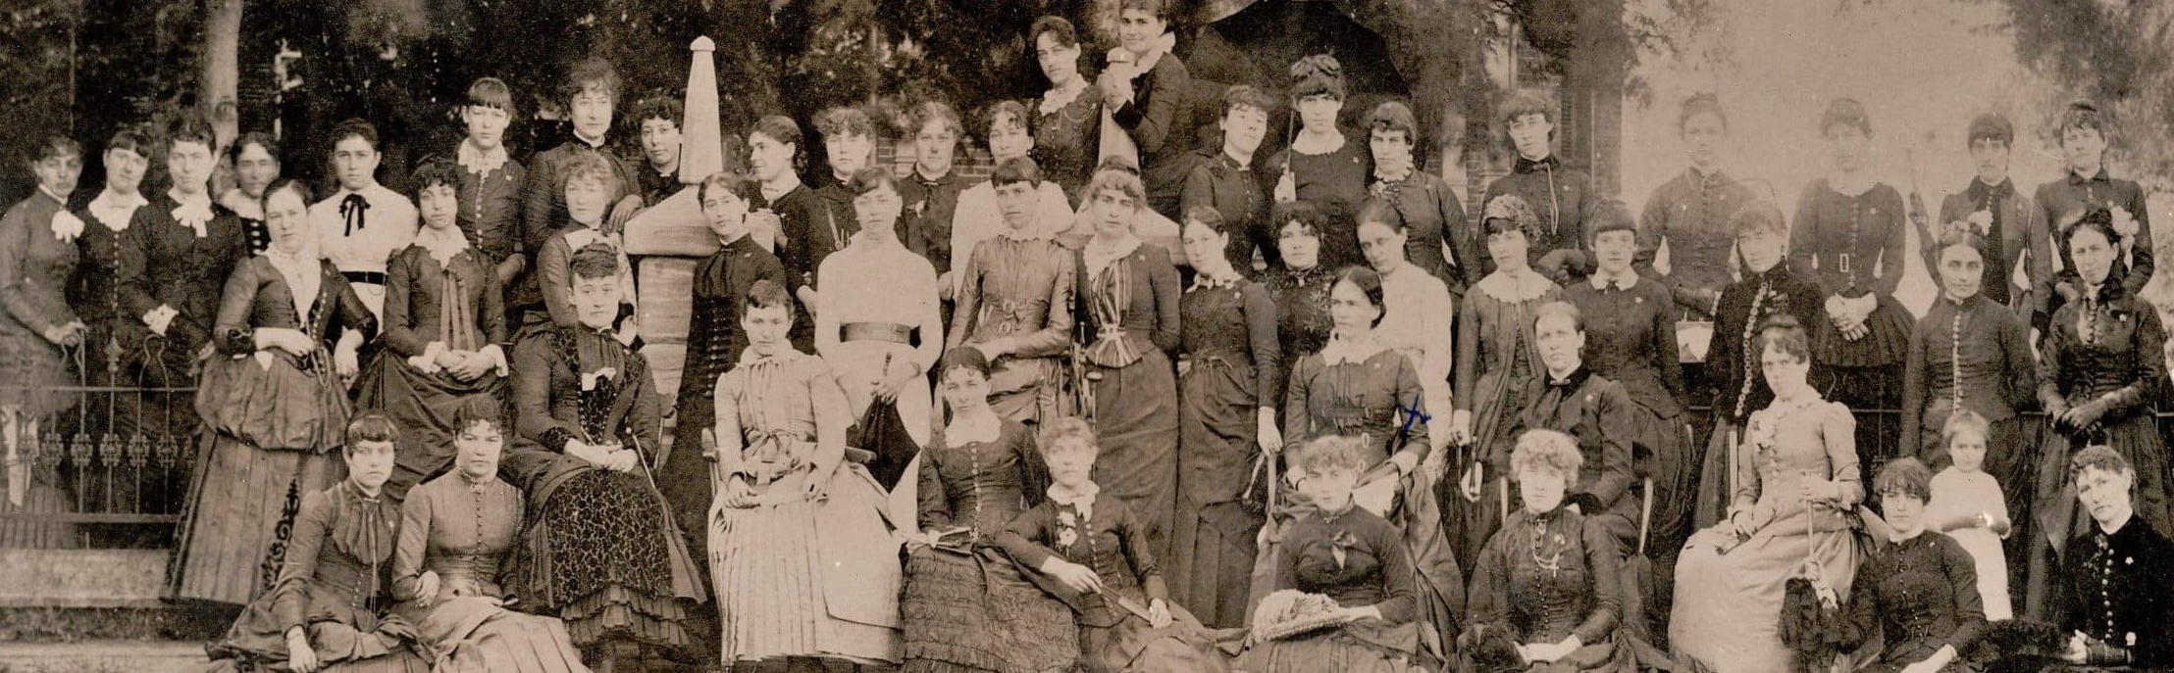
From its inception, the P.E.O. has had, as its mission, the advancement of women. During its growth years it achieved international status as chapters were soon formed in Canada.

Slide 39
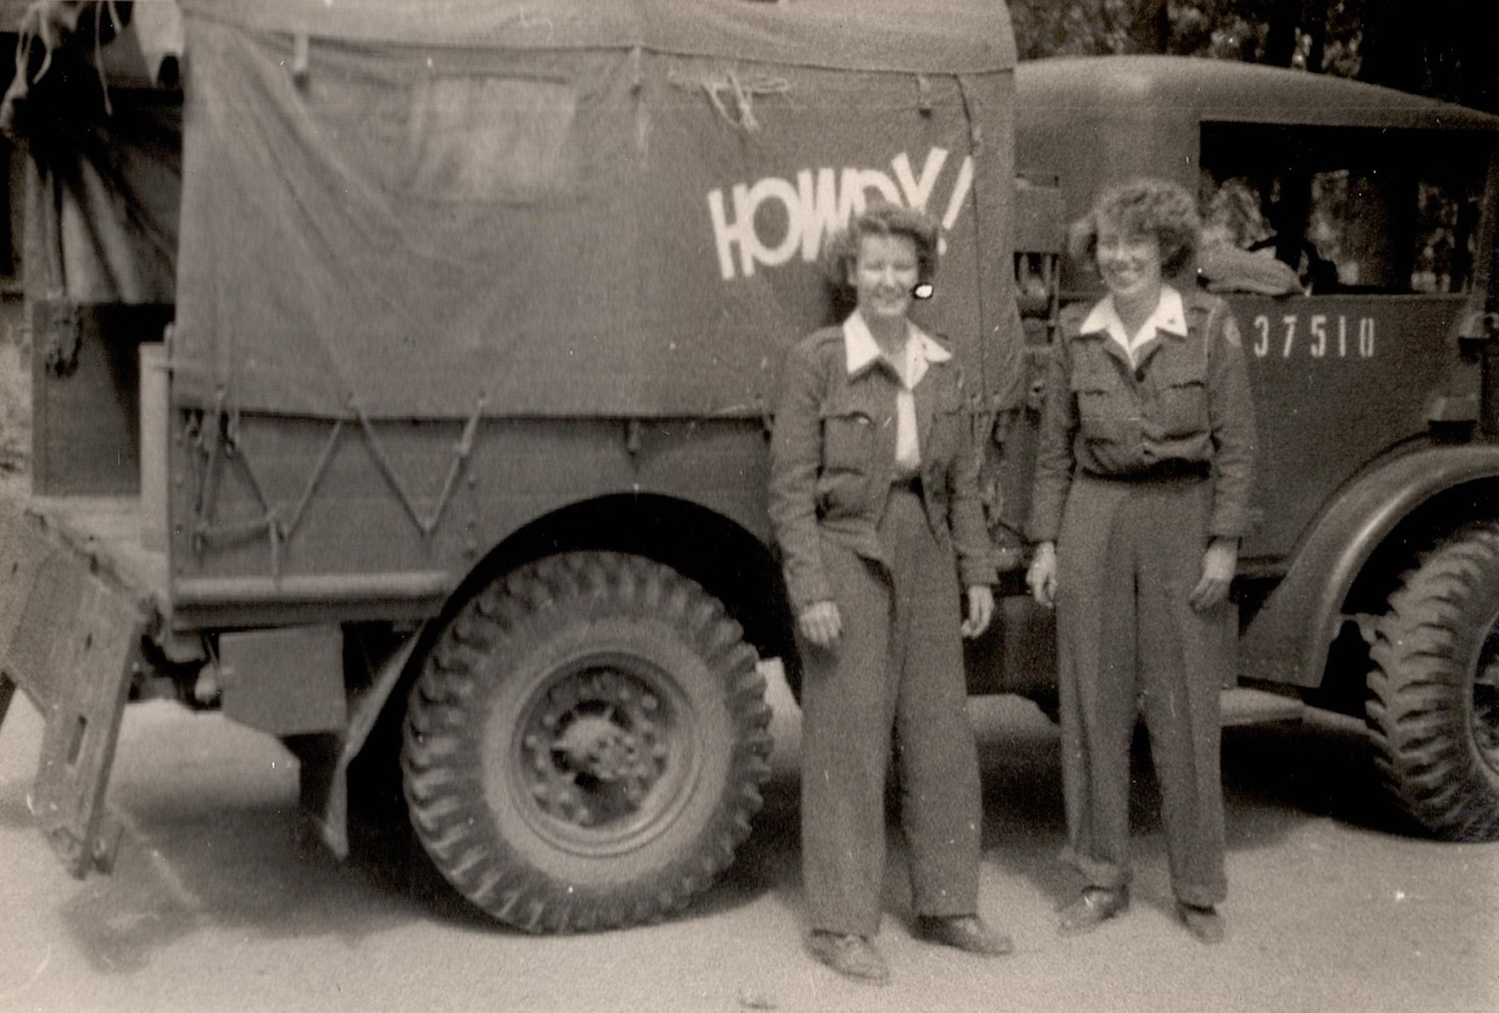

Slide 40
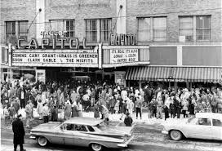
In 1956, seven women came to Rome – most likely following their husbands to Griffiss AFB. They were P.E.O. members from other parts of the country and instrumental in forming the Chapter AU, P.E.O. in Rome, which joined the other women run philanthropic organizations already in existence. On April 14, 1956, Chapter AU was formally organized, becoming the 47th such chapter in New York State.
Rome Chapter AU presents an annual award to a local graduating female student, joining the nearly 6,000 chapters in the US and Canada in gifting over $304 million dollars as of 2017.

Slide 41
Philanthropic endeavors through the organization’s history, and continuing today include
Cottey College, owned and supported by the P.E.O. since 1927.
The Education Loan Fund
International Peace Scholarships
Programing for Continuing Education
Scholar Award
STAR Scholarship

Slide 42
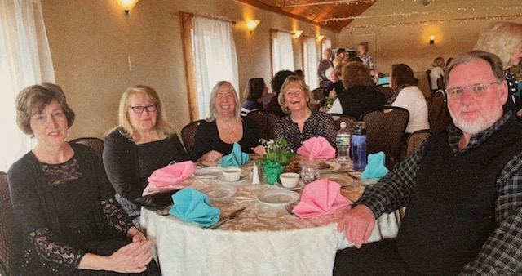

Slide 43
If you want something done,
ask a busy woman!

Slide 44
Off with the Apron On with the Hat
The Progressive Era and the Rise of
Women’s Organizations

